Slide 1
Chapter 5 Object Oriented Design
OO Design Overview
Architectural Design
Use Case Design
Subsystem Design
Class Design

Slide 2
OO Design Overview

Slide 3
5.1 OO Design Overview
Understanding Design
Analysis Versus Design
Object Oriented Design

Slide 4
Understanding Design
A process that uses the products of analysis to produce a specification for implementing a system.
A logical description of how a system will work.
Emphasizes a conceptual solution (in software and hardware) that fulfills the requirements, rather than its implementation.
“do the right thing (analysis), and do the thing right (design)”.

Slide 5
Analysis Versus Design
Analysis
  Focus on understanding the problem
  Idealized design
  Behavior
  System structure
  Functional requirements
  A small model
Design
  Focus on understanding the solution
  Operations and Attributes
  Performance
  Close to real code
  Object lifecycles
  Non-functional requirements
  A large model
Notes:
An instructor once said: “Analysis Vs. Design is important because of the mind-set. If you tried to manage all of the analysis and design issues in one go, your brain would explode on all but the most trivial developments. It’s just too much to take in, comprehend, and model in one go. So I mentally switch “OK, analysis - problem domain - don’t care about memory, persistence, databases, language, etc”. “Right now it’s design and I do care about all those things - but now I can stop thinking (too a degree) about trying to understand the business domain.” It’s about managing the 7+/-2 things I can think about in one go. It also separates out the skills (a bit).”
Another instructor once said: “analysis is the study of and eventual comprehension of “some thing” [the problem space]. But to understand it, we must invent some entities to hold onto the thing that we have just grasped - this inventive process is design. That is, human cognitive thinking is actually interwoven analysis/design and any attempt to separate them is really only an idealization. Therefore, if I try to apply two separate “steps” in the production of, say, a class diagram [and call those steps A and then D], I will introduce ambiguity into my process because cognitive process forces one to “produce a solution” in order to “understand a problem” - that D is necessary to have any results from A.”
Think of analysis as an idealized design step - where we ignore several complicating issues. This can turn into a religious debate.

Slide 6
Object Oriented Design
The specification of a logical software solution in terms of software objects,
  such as their classes, attributes, methods, and collaborations.
During object-oriented design (or simply, object design) there is an emphasis on defining software objects and how they collaborate to fulfill the requirements.

Slide 7
Architectural Design

Slide 8
5.2 Architectural Design
Architectural Patterns
Resolution of Architectural Factors
Identify Design Elements
Organizing the design model packages
Notes:
The following page numbers will help the instructor find the answers to the review questions:
Question 1: pp. 3-4
Question 2: p. 4
Question 3: p. 10
Question 4: p. 6
Question 5: pp. 8-9

Slide 9
What is An Architectural Pattern?
An architectural pattern expresses a fundamental structural organization schema for software systems. It provides a set of predefined subsystems, specifies their responsibilities, and includes rules and guidelines for organizing the relationships between them – Buschman et al, “Pattern-Oriented Software Architecture— A System of Patterns””
Architectural patterns - Common Architectural Styles
  Layers
  Model-view-controller (M-V-C)
  Pipes and filters
  Blackboard
Notes:
The chosen architectural pattern may change, in some significant ways, the approach taken to solving a problem (i.e., choosing another pattern would require too much “tweaking” in design), Thus, you want to account for this in analysis; however, be careful not to make the analysis approach too vendor–specific.
Some examples:
Layers: The Course Registration and Payroll architecture; The OSI 7 level model
MVC: Rose, GUI, Image Processing Tools
Pipes and Filters: Telecom Billing (processing of incoming calls).
Remind the students that this is not an architecture course. Thus, for scope reasons, our discussions will be limited to the layered pattern.
Note: Client/Server and 2/3/n-tier have sometimes been called an analysis pattern, but in this course is will be treated as a distribution pattern and will be discussed in the Describe Distribution module.
Architectural Analysis is where you consider architectural patterns, as this choice affects the high-level organization of your object model.
Layers: The Layers pattern is where an application is decomposed into different levels of abstraction. The layers range from application-specific layers at the top to implementation/technology-specific layers on the bottom.
Model-View-Controller: The MVC pattern is where an application is divided into three partitions: The Model which is the business rules and underlying data, the View which is how information is displayed to the user, and the Controllers which process the user input.
Pipes and Filters: In the Pipes and Filters pattern, data is processed in streams that flow through pipes from filter to filter. Each filter is a processing step.
Blackboard: The Blackboard pattern is where independent specialized applications collaborate to derive a solution, working on a common data structure.
Architectural patterns can work together (i.e., more than one architectural pattern can be present in any one software architecture).
The architectural patterns listed above imply certain system characteristics, performance characteristics, and process and distribution architectures. Each solves certain problems but also poses unique challenges. For this course we will concentrate on the Layers architectural pattern.

Slide 10
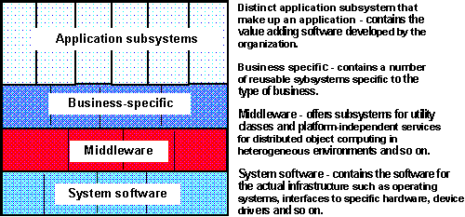
Typical Layering Approach
Specific functionality
General functionality
Notes:
Remind the students that during Architectural Analysis, focus is normally on the high-level layers, that is, the application and business-specific layers, The other lower-level layers are focused on during Incorporate Existing Design Elements.
Layering is another realization of the basic OO principles discussed in the Introduction to Object Orientation module: abstraction, encapsulation, modularity and hierarchy.
Layering is fundamental separation of concerns.
Note: Most of the GUI and persistence frameworks cut across layers in a somewhat transparent way, so instead of visualizing layers in only two dimensions, think of a framework as layering in a third dimension that cuts across the normal layering dimensions (or “plugs into” the side of the layering diagram, cutting across layers). This is part of what makes frameworks so hard to explain - they don’t behave like “service providers” (classes and subsystems), but instead act more like skeletal architectures and proto-services that both extend and are extended by the project-specific stuff. The “GUI layer” is really not so much a layer but a framework that extends across a number of layers.
Layering represents an ordered grouping of functionality, with the application-specific functions located in the upper layers, functionality that spans application domains in the middle layers, and functionality specific to the deployment environment at the lower layers.
The number and composition of layers is dependent upon the complexity of both the problem domain and the solution space:
There is generally only a single application-specific layer.
In domains with existing systems, or that have large systems composed of inter-operating smaller systems, the Business-specific layer is likely to partially exist and may be structured into several layers for clarity.
Solution spaces which are well-supported by middleware products and in which complex system software plays a greater role will have well-developed lower layers, with perhaps several layers of middleware and system software.
This slide shows a sample architecture with four layers:
The top layer, application layer, contains the application specific services.
The next layer, business-specific layer, contains business specific components used in several applications.
The middleware layer contains components such as GUI-builders, interfaces to database management systems, platform-independent operating system services, and OLE-components such as spreadsheets and diagram editors.
The bottom layer, system software layer, contains components such as operating systems, databases, interfaces to specific hardware and so on.

Slide 11
Examples of Architectural Patterns - Layers
1) Pattern Name:
Layers
2) Context
A large system that requires decomposition.
3) Problem
A system which must handle issues at different levels of abstraction. For example: hardware control issues, common services issues and domain-specific issues. It would be extremely undesirable to write vertical components that handle issues at all levels. The same issue would have to be handled (possibly inconsistently) multiple times in different components.

Slide 12
Examples of Architectural Patterns - Layers
4) Forces
Parts of the system should be replaceable. Changes in components should not ripple Similar responsibilities should be grouped together Size of components -- complex components may have to be decomposed
5) Solution
Structure the systems into groups of components that form layers on top of each other. Make upper layers use services of the layers below only (never above). Try not to use services other than those of the layer directly below (don’t skip layers unless intermediate layers would only add pass-through components).

Slide 13
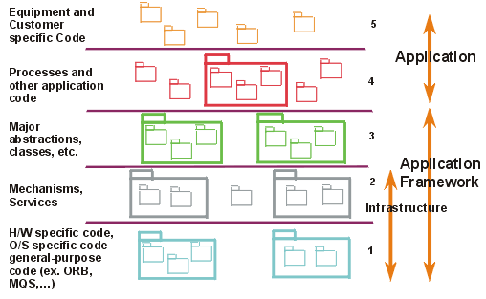
Examples of Architectural Patterns - Layers

Slide 14
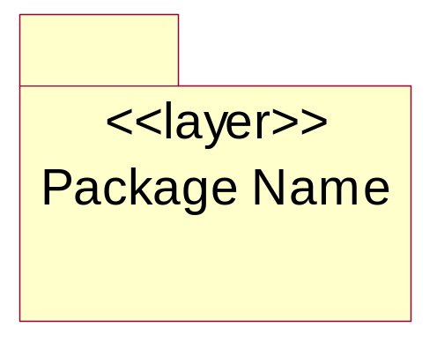
Modeling Architectural Layers
Architectural layers can be modeled using stereotyped packages
<<layer>> stereotype
Notes:
Layers can be represented in Rose as packages with the <<layer>> stereotype. The layer descriptions can be included in the documentation field of the specification of the package.

Slide 15
Layer – Reuse driving
<<layer>>
Application
<<layer>>
Business-Specific
<<layer>>
Middleware

Slide 16
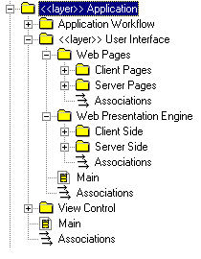
Example – Application Layer

Slide 17
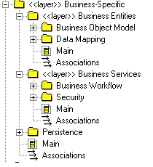
Example – Business Specific Layer

Slide 18
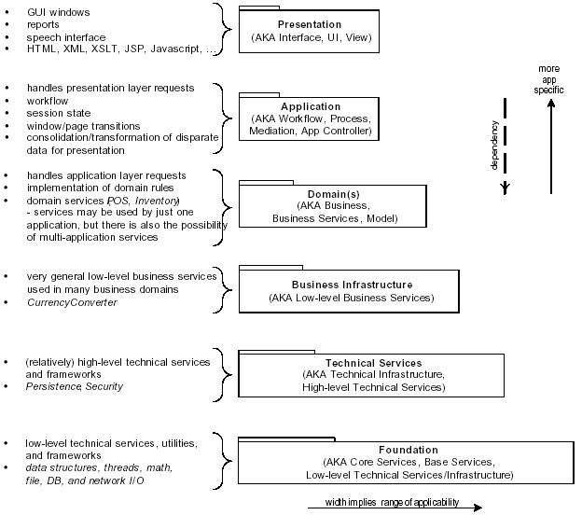
Examples of Architectural Patterns - Layers

Slide 19
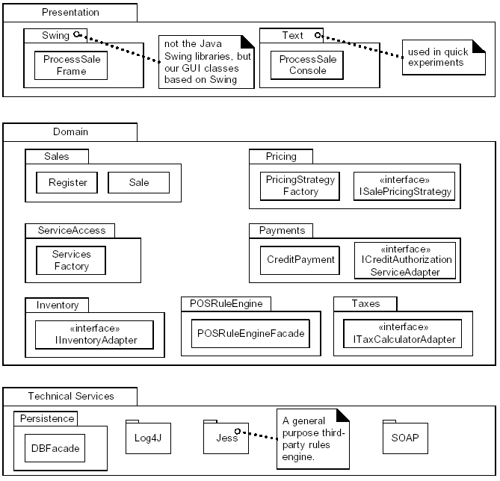
Partial logical view of layers in the NextGen application

Slide 20
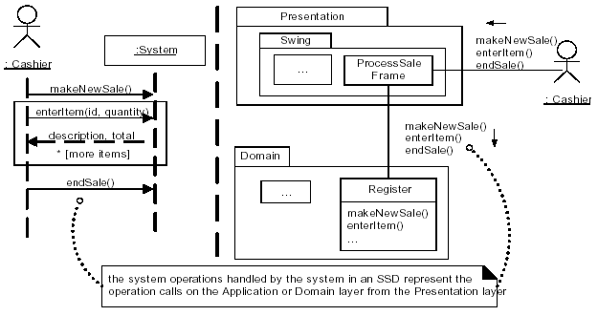
System Operations and Layers
Notes:
The following page numbers will help the instructor find the answers to the review questions:
Question 1: pp. 3-4
Question 2: p. 4
Question 3: p. 10
Question 4: p. 6
Question 5: pp. 8-9

Slide 21
Upward Collaboration with Observer
When the lower Application or Domain layer needs to communicate upward with the Presentation layer, it is usually via the Observer pattern
  UI objects in the higher Presentation layer implement an interface such as Property Listener or AlarmListener, and are subscribers or listeners to events (such as property or alarm events) coming from objects in the lower layers.
  The lower layer objects are directly sending messages to the upper layer UI objects,but the coupling is only to the objects viewed as things that implement an interface such as PropertyListener, not viewed as specific GUI windows.
Notes:
The following page numbers will help the instructor find the answers to the review questions:
Question 1: pp. 3-4
Question 2: p. 4
Question 3: p. 10
Question 4: p. 6
Question 5: pp. 8-9

Slide 22
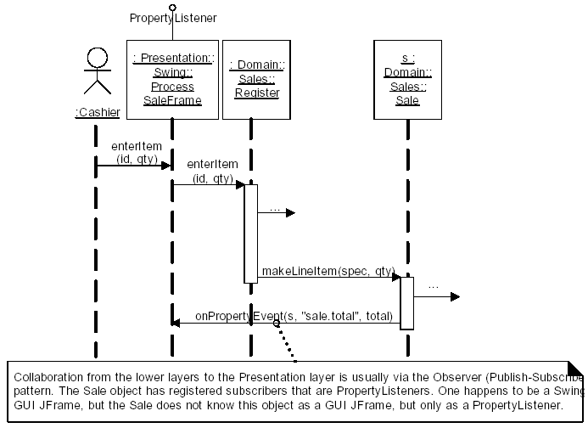
Upward Collaboration with Observer
Notes:
The following page numbers will help the instructor find the answers to the review questions:
Question 1: pp. 3-4
Question 2: p. 4
Question 3: p. 10
Question 4: p. 6
Question 5: pp. 8-9

Slide 23
Comments on typical coupling between layers
All higher layers have dependencies on the Technical Services and Foundations layer
  For example, in Java all layers depend onjava.util package elements
It is primarily the Domain layer that has dependency on the Business Infrastructure layer
Presentation layer makes calls on the Application layer, which makes service calls on the Domain layer;
  the Presentation layer does not call on the Domain, unless there is no Application layer.
If it is a single-process "desktop" application, software objects in the Domain layer are directly visible to, or passed between, Presentation, Application, and to a lesser extent, Technical Services.
If it is a distributed system, then serializable replicates (also known as data holder or value objects) of objects in the Domain layer are usually passed to a Presentation layer.
  In this case, the Domain layer is deployed on a server computer, and client nodes get copies of server data.
Notes:
The following page numbers will help the instructor find the answers to the review questions:
Question 1: pp. 3-4
Question 2: p. 4
Question 3: p. 10
Question 4: p. 6
Question 5: pp. 8-9

Slide 24
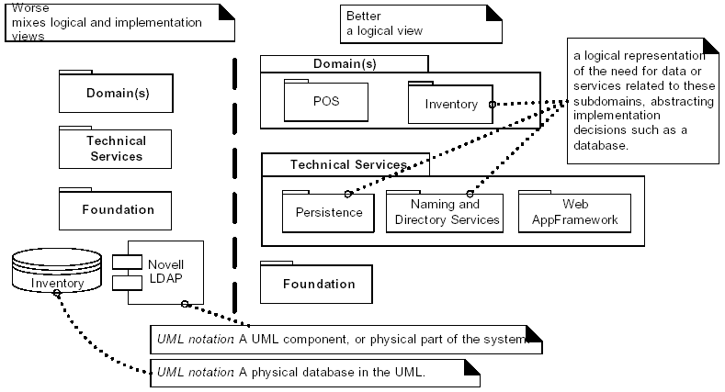
Mixing views of the architecture
Notes:
The following page numbers will help the instructor find the answers to the review questions:
Question 1: pp. 3-4
Question 2: p. 4
Question 3: p. 10
Question 4: p. 6
Question 5: pp. 8-9

Slide 25
Terminology: Tiers, Layers, and Partitions
The original notion of a tier in architecture was a logical layer, not a physical node, but the word has become widely used to mean a physical processing node (or cluster of nodes)
  such as the "client tier" (the client computer)..
The layers of an architecture are said to represent the vertical slices
The partitions represent a horizontal division of relatively parallel subsystems of a layer.
Notes:
The following page numbers will help the instructor find the answers to the review questions:
Question 1: pp. 3-4
Question 2: p. 4
Question 3: p. 10
Question 4: p. 6
Question 5: pp. 8-9

Slide 26
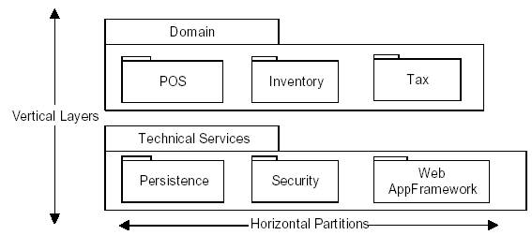
Layers and partitions
Notes:
The following page numbers will help the instructor find the answers to the review questions:
Question 1: pp. 3-4
Question 2: p. 4
Question 3: p. 10
Question 4: p. 6
Question 5: pp. 8-9

Slide 27
Layer - N-Tier (C/S)
Client A
Client N
…...
Server

Slide 28

Layer - N-Tier (3 tier)
Thinner client, thicker server
Client A
Client B
Application
Client C
Application
WWW Browser
Business Object
Services
DCOM
ADO/R
CORBA
Beans
Business Object
Engine
Web
Server
HTML
CGI
ASP
Java
Business Object Server
COM
MTS
Beans
ETS
Business Object
Services
Business Object
Services
Business Object
Engine
Business Object
Engine
Relational Database Server(s)

Slide 29
Layer - N-Tier (n-tier)
HTML, Script Languages, ...
Client/Browser
Web Server
JSP, Servlets, CGI, ...
Application Server
EJB, CORBA, COM+
Database
Server
Legend
System
Native languages

Slide 30
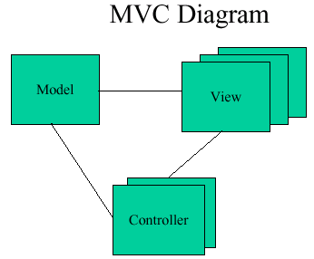
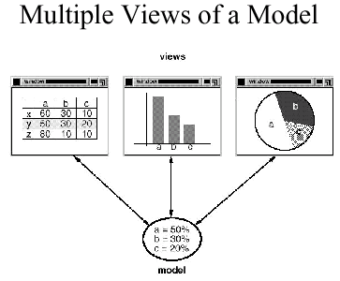
Architectural Pattern - MVC
• Name: MVC (Model-View-Controller)
• Context and forces: we have a data model and several representations of the data
– We want to modularize the system
– Data representation must be kept up to date
• Problem: how to modularize the system
• Solution: the model holds the data (and does data modification), the view represents the data, the controller handles user input

Slide 31


Model-View-Controller Architecture
The model-view-controller architecture (MVC) separates application data (contained in the model) from graphical presentation components (the view) and input-processing logic (the controller).
Java’s Swing components implement a variation of MVC that combines the view and controller into a single object, called a delegate. The delegate provides both a graphical presentation of the model and an interface for modifying the model.
For example, every JButton has an associated ButtonModel for which the JButton is a delegate.The ButtonModel maintains state information, such as whether the JButton is pressedand whether the JButton is enabled, as well as a list of ActionListeners. The JButton provides a graphical presentation and modifies the ButtonModel’s state.
Notes:
In the Best Practices module, we discussed some characteristics common to successful projects. OO facilitates the following best practices:
Develop Iteratively
Model Visually
Use Component Architecture
Defining basic OO terms and concepts allows everyone in the class to start on a level playing field.

Slide 32
Examples of Architectural Patterns - Blackboard
1) Pattern Name
Blackboard
2) Context
A domain in which no closed (algorithmic) approach to solving a problem is known or feasible. Examples are AI systems, voice recognition, and surveillance systems.
3) Problem
Multiple problem-solving agents (knowledge agents) must cooperate to solve a problem that cannot be solved by any of the individual agents. The results of the work of the individual agents must be accessible to all the other agents so they can evaluate whether they can contribute to finding a solution and post results of their work.

Slide 33
Examples of Architectural Patterns - Blackboard
4) Forces
Sequence in which knowledge agents can contribute to solving the problem is not deterministic and may depend on problem solving strategies. Input from different agents (results or partial solutions) may have different representations. Agents do not know of each other's existence directly but can evaluate each other's posted contributions
5) Solution
A number of Knowledge Agents have access to a shared data store called the Blackboard. The blackboard provides an interface to inspect and update its content. The Control module/object activates the agents following some strategy. Upon activation an agent inspects that blackboard to see if it can contribute to solving the problem. If the agent determines that it can contribute, the control object can allow the agents to put its partial (or final) solution on the board.

Slide 34
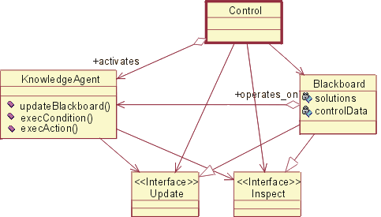
Examples of Architectural Patterns - Blackboard

Slide 35
Resolution of Architectural Factors

Slide 36
Resolution of Architectural Factors
Recording Architectural Alternatives, Decisions, and Motivation - technical memos
Example of Technical Memo
Notes:
The following page numbers will help the instructor find the answers to the review questions:
Question 1: pp. 3-4
Question 2: p. 4
Question 3: p. 10
Question 4: p. 6
Question 5: pp. 8-9

Slide 37
Design Model Overview
Requirement Model
Design Model
Use case
Use case realization
Layered Architecture
Use case report
<<layer>>
Special Application
<<layer>>
General Application
Glossary
<<layer>>
General Services
<<layer>>
System Services
Supplementary Specification
Architecture Mechanism

Slide 38
Technical Memo
All architectural methods recommend keeping a record of alternative solutions, decisions, influential factors, and motivations for the noteworthy issues and decisions.
Such records have been called technical memos, issue cards, and architectural approach documents, with varying degrees of formality and sophistication.
  In some methods, these memos are the basis for yet another step of review and refinement.
In the UP, the memos should be recorded in the SAD.
An important aspect of the technical memo is the motivation or rationale.
Explaining the rationale of rejecting the alternatives is important.
Notes:
The following page numbers will help the instructor find the answers to the review questions:
Question 1: pp. 3-4
Question 2: p. 4
Question 3: p. 10
Question 4: p. 6
Question 5: pp. 8-9

Slide 39
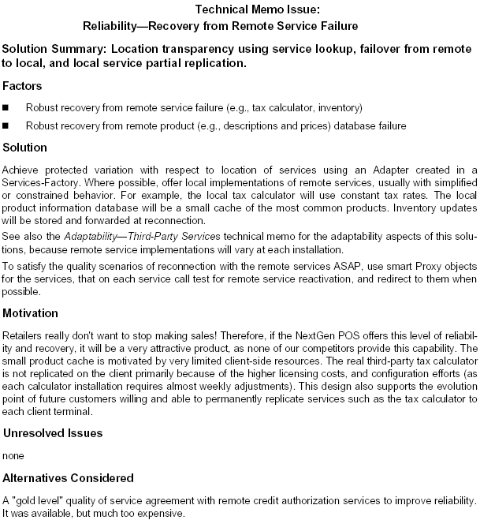
Example of Technical Memo
Notes:
The following page numbers will help the instructor find the answers to the review questions:
Question 1: pp. 3-4
Question 2: p. 4
Question 3: p. 10
Question 4: p. 6
Question 5: pp. 8-9

Slide 40
Architectural Information in the UP Artifacts
The architectural decisions are recorded in the SAD(Software Architecture Document).
  This includes the technical memos and descriptions of the architectural views.
Notes:
The following page numbers will help the instructor find the answers to the review questions:
Question 1: pp. 3-4
Question 2: p. 4
Question 3: p. 10
Question 4: p. 6
Question 5: pp. 8-9

Slide 41
Sample Structure of a SAD
Architectural Representation
  (Summary of how the architecture will be described in this document, such as using by technical memos and the architectural views. This is useful for someone unfamiliar with the idea of technical memos or views. Note that not all views are necessary.)
Architectural Factors and Decisions
  (Reference to the Supplementary Specification to view the Factor Table. Also, the set of technical memos the summarize the decisions.)
Logical View
  (UML package diagrams, and class diagrams of major elements. Commentary on the large scale structure and functionality of major components.)
Process View
  (UML class and interaction diagrams illustrating the processes and threads of the system. Group this by threads and processes that interact. Comment on how the interprocess communication works (e.g., by Java RMI).
Use-Case View
  (Brief summary of the most architecturally significant use cases. UML interaction diagrams for some architectural significant use-case realizations, or scenarios, with commentary on the diagrams explaining how they illustrate the major architectural elements.)
Deployment View
  (UML deployment diagrams showing the nodes and allocation of processes and components. Commentary on the networking.)
Data View
  Overview of the persistent data schema, the schema mapping from objects to persistent data (usually in a relational database), the mechanism of mapping from objects to a database, database stored procedures and triggers.
  A view onto the UP Data Model, visualized with UML class diagrams used to describe a data model.
Notes:
The following page numbers will help the instructor find the answers to the review questions:
Question 1: pp. 3-4
Question 2: p. 4
Question 3: p. 10
Question 4: p. 6
Question 5: pp. 8-9

Slide 42
Identify Design Elements

Slide 43
Identify Design Elements
Purpose：
To analyze interactions of analysis classes to identify design model elements
Identify Classes, Active Classes and Subsystems
Identify Subsystem Interfaces
Identify and Specify Events
Identify and Specify Signals

Slide 44
Identify Design Elements
analysis classes represent conceptual things which can perform behavior.
In design, analysis classes evolve into a number of different kinds of design elements:
classes, to represent a set of rather fine-grained responsibilities;
subsystems, to represent a set of coarse-grained responsibilities, perhaps composed of a further set of subsystems, but ultimately a set of classes;
active classes, to represent threads of control in the system;
interfaces, to represent abstract declarations of responsibilities provided by a class or subsystem.

Slide 45
Identify Design Elements
In addition, in design we shall also identify:
events, which are specifications of interesting occurrences in time and space that usually (if they are noteworthy) require some response from the system; and
signals, to represent asynchronous mechanisms used to communicate certain types of events within the system.
Events and the Signals that are used to communicate them, allow us to describe the asynchronous triggers of behavior to which the system must respond.

Slide 46
Packages versus Subsystems
Subsystems
  Provide behavior
  Completely encapsulate their contents
  Are easily replaced
Packages
  Don’t provide behavior
  Don’t completely encapsulate their contents
  May not be easily replaced
Client Class
Package B
ClassB1
<<subsystem>>
ClassB2
Subsystem A
Encapsulation is the key!
Notes:
The UML supports the concept of a subsystem, which has different semantics than just the package semantics (though a subsystem “inherits from” package in the UML metamodel). You can model a subsystem as a package with the «subsystem» stereotype. See the modeling convention slide provided later in this module for more information.
A subsystem is a special kind of package whose behavior is important enough to be extracted out into interface(s).
Subsystems ALWAYS have an interface. If a package has an “interface” (a small number of public classes), it is really a subsystem. Not all packages are subsystems. only subsystems realize interfaces
Emphasize that all dependencies on a subsystem should be through it’s interface!
Subsystems and packages are very alike, but are different in some essential ways. A subsystem provides interfaces by which the behavior it contains can be accessed. Packages provide no behavior; they are simply containers of things which have behavior. Packages help organize and control sets of classes that are needed in common, but which aren’t really subsystems. Packages are just used for model organization and configuration management.
Subsystems completely encapsulate their contents, providing behavior only through their interfaces. Dependencies on a subsystem are on it’s interface(s), not on specific subsystem contents. With packages, dependencies are on specific elements within the package.
With subsystems, the contents and internal behaviors of a subsystem can change with complete freedom as long as the subsystem's interfaces remain constant. With packages, it is impossible to substitute packages for one another unless they have the same public classes. The public classes and their public operations get frozen by the dependencies external classes have on them. Thus, the designer is not free to eliminate these classes or change their behaviors if a better idea presents itself.
Note: Even when using packages, it is important that you hide the implementation from elements external to the package. All dependencies on a package should be on the public classes of the package. Public classes can be considered the interface of the package and should be managed as such (stabilized early).

Slide 47
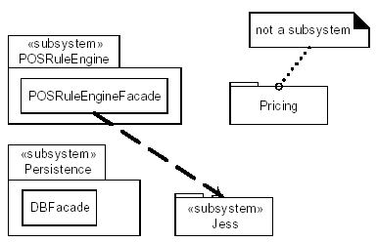
Subsystem example

Slide 48
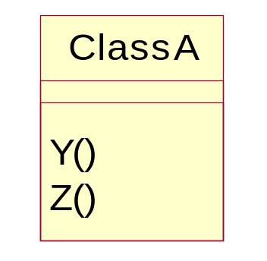

Identifying Subsystems
“Superman Class”
<<Interface>>
<<subsystem>>
Subsystem K
Y()
Z()
Notes:
Subsystems may also be defined as part of the detailed design of any design element. Subsystems may be identified at any point in the design process, any time a “chunk of responsibility” is discovered that is bigger than a class.
In any case, most of the time, subsystems play a major role in the software architecture.
When the analysis class is complex, such that it appears to embody behaviors that cannot be the responsibility of a single class acting alone, or the responsibilities may need to be reused, the analysis class should be refined into a subsystem. This is a decision based largely on conjecture guided by experience. The actual representation may take a few iterations to stabilize.
As discussed earlier, the use of a subsystem allows the interface to be defined and stabilized, while leaving the design details of the interface implementation to remain hidden while its definition evolves.
The decision to make something a subsystem is often driven by the knowledge and experience of the Architect. Since it tends to have a strong effect on the partitioning of the solution space, the decision needs to be made in the context of the whole model. It is the result of more detailed design knowledge, as well as the imposition of constraints imposed by the implementation environment.
When an analysis class is evolved into a subsystem, the responsibilities that were allocated to the “superman” analysis class are then allocated to the subsystem and an associated interface (i.e., they are used to define the interface operations). The details of how that subsystem actually implements the responsibilities (i.e., the interface operations) is deferred until Subsystem Design.

Slide 49
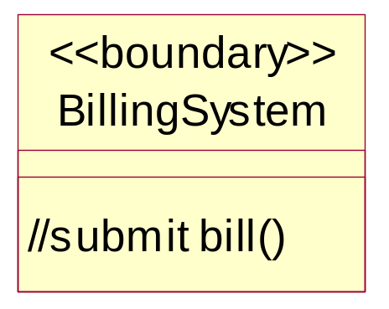
Example: Design Subsystems and Interfaces
Analysis
Design
<<subsystem>>
Billing System
IBillingSystem
submitBill(forTuition : Double, forStudent : Student)
<<boundary>>
<<subsystem>>
CourseCatalogSystem
Course Catalog
System
//get course offerings()
ICourseCatalogSystem
getCourseOfferings(forSemester : Semester, forStudent : Student) : CourseOfferingList
initialize()
Notes:
Emphasize the rationale for choosing these subsystems -- external system access.
During Use-Case Analysis, we modeled two boundary classes, the BillingSystem and the CourseCatalogSystem, whose responsibilities were to cover the details of the interfaces to the external systems. It was decided by the Architects of the Course Registration System that the interactions to support external system access will be more complex than can be implemented in a single class. Thus, subsystems were identified to encapsulate these responsibilities and provide interfaces that give the external systems access. The above diagram includes these subsystems, as well as their interfaces.
The BillingSystem subsystem provides an interface to the external billing system. It is used to submit a bill when registration ends and students have been registered in courses.
The CourseCatalogSystem subsystem encapsulates all the work involved for communicating to the legacy Course Catalog System. The system provides access to the unabridged catalog of all courses and course offerings offered by the university including those from previous semesters.
These are subsystems rather than packages because a simple interface to their complex internal behaviors can be created. Also, by using a subsystem with an explicit and stable interface, the particulars of the external systems to be used (in this case, the Billing System and the legacy Course Catalog System) could be changed at a later date with no impact on the rest of the system.

Slide 50
Modeling Convention: Subsystems and Interfaces
<<subsystem>> package
<<subsystem>>
CourseCatalogSystem
ICourseCatalogSystem
<<subsystem proxy>> class
Interfaces start with an “I”
<<subsystem proxy>>
CourseCatalogSystem
ICourseCatalogSystem
getCourseOfferings(forSemester : Semester, forStudent : Student) : CourseOfferingList
getCourseOfferings()
initialize()
initialize()
Notes:
There may be some concern over the use of “proxy”. However, using <<subsystem proxy>> should remove any ambiguous confusion with the "proxy" design pattern (although it is in a loose way an instance of the design pattern, at least at design time).
Note: The stereotype was changed from <<façade>> to <subsystem proxy>> in RUP v5.5).
This convention is useful when using Rose since Rose does not fully support subsystems yet (you can’t include subsystems in interaction diagrams). The subsystem proxy class may act in place of the subsystem in sequence diagrams, and collaboration diagrams in which a subsystem cannot (today) appear in Rose. Use a subsystem proxy when you want to indicate usage of a specific subsystem. The subsystem proxy realizes the interfaces realized by the subsystem. To enable the "subsystem proxy" to provide all of the operations defined by the interfaces of the subsystem create a new Class Diagram in the subsystem package and give it the name "Interface Realizations." You can then drag and drop the "subsystem proxy" class into the new diagram. Draw realization associations from the "subsystem proxy" class to the interface classes that the proxy realizes, making sure that all the interface operations are defined in the "subsystem proxy" class.
For this course, we will represent subsystems as three items in the model:
A <<subsystem>> package (i.e., package with a stereotype of <<subsystem>>),
A <<subsystem proxy>> class (i.e., class with a stereotype of <<subsystem proxy>>), and
A subsystem interface (class with a stereotype of <<interface>>. The interface names will start with an ‘I’.
The <<subsystem>> package provides a container for the elements that comprise the subsystem, the interaction diagrams that describe how the subsystem elements collaborate to implement the operations of the interfaces the subsystem realizes, and other diagrams that clarify the subsystem elements. The subsystem realizes the interface.
The <<subsystem proxy>> class realizes the interface(s) (as a proxy) and will orchestrate the implementation of the subsystem interface(s) operations. (More on this in Subsystem Design.)
Such conventions make the consistent modeling of subsystems easier. We will see later in the course how we utilize this convention in representing subsystems on our diagrams.
Remember, interfaces are EXTERNAL to the subsystem package.

Slide 51
Façade in subsystem
For subsystems, the most common pattern of access is Facade, a GoF design pattern.
  a public facade object defines the services for the subsystem, and clients collaborate with the facade, not internal subsystemcomponents
The Facade pattern is commonly used for "downward" collaboration from a higher to a lower layer, or for access to services in another subsystem of the same layer.
The facade should not normally expose many low-level operations.
  Rather, to expose a small number of high-level operations—the coarse-grained services.
A facade does not normally do its own work.
  Rather, it is consolidator or mediator to the underlying subsystem objects, which do the work.
Notes:
The following page numbers will help the instructor find the answers to the review questions:
Question 1: pp. 3-4
Question 2: p. 4
Question 3: p. 10
Question 4: p. 6
Question 5: pp. 8-9

Slide 52
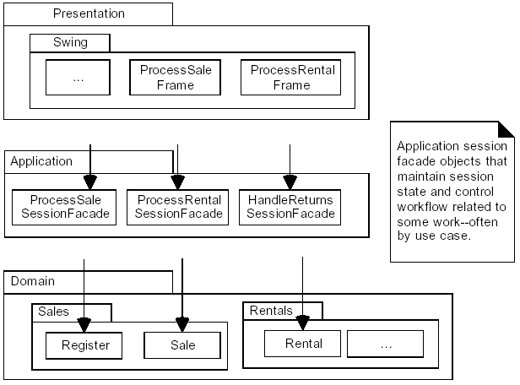
Session Facades and the Application Layer
Notes:
The following page numbers will help the instructor find the answers to the review questions:
Question 1: pp. 3-4
Question 2: p. 4
Question 3: p. 10
Question 4: p. 6
Question 5: pp. 8-9

Slide 53
Organizing the Design Model
Packages

Slide 54
Review: What Is a Package?
A package is a general purpose mechanism for organizing elements into groups.
It is a model element that can contain other model elements.
A package can be used
  To organize the model under development.
  As a unit of configuration management.
University
Artifacts
Notes:
Packages were first introduced in the Introduction to Object Orientation module. The slide is repeated here for review purposes.
Packages can be used to group any model elements. However, in this module, we will be concentrating on how they are used within the Design Model.
Before discussing how to define the upper-level layers, let’s review some key concepts that we depend on in this step.

Slide 55
Package Relationships: Dependency
Packages can be related to one another using a dependency relationship
Dependency Implications
    Changes to the Supplier package may affect the Client package
    The Client package cannot be reused independently because it depends on the Supplier package
Dependency relationship
Client Package
Supplier
Package
Notes:
Generalization relationships are also permitted between packages.
Refinement relationships are also permitted for packages. However, these will be discussed as the realizes relationships between interfaces and the subsystems that realize those interfaces.
Interfaces and Subsystems will be discussed in Identify Design Elements.
Currently, in Rose, the only relationship that is supported between packages is dependency.
Elements in one package can import elements in another package. In the UML, this is represented as a dependency relationship.
The relationships of the packages reflect the allowable relationships between the contained classes. A dependency relationship between packages indicates that the contents of the supplier packages may be referenced by the client. In the above example, if a dependency relationship exists between the Client package and the Supplier package, then classes in the Client package may access classes in the Supplier package.
Some of the implications of package dependency are:
Whenever a change is made to the Supplier package, the Client package must, potentially, be recompiled and re-tested.
The Client package cannot be reused independently because it depends on the Supplier package
The grouping of classes into logical sets and the modeling of their relationships can occur anywhere in the process when a set of cohesive classes are identified.

Slide 56
Avoiding Circular Dependencies
A
A
Hierarchy should be acyclic
B
B
A
C
B
A'
C
Circular dependencies make it impossible to reuse one package without the other
Notes:
In Architectural Analysis, it is important to recognize that cycles are bad and should be avoided, when possible. However, resolving circular dependencies should really be focussed on in Incorporate Existing Design Elements.
It is desirable that the package hierarchy be acyclic. This means that the following situation should be avoided (if possible):
Package A uses package B which uses package A
If a circular dependency exists between Package A and Package B, if you change Package A it might cause a change in Package B, which might cause a change in Package A, etc. A circular dependency between packages A and B means that they will effectively have to be treated as a single package.
Circles wider than two packages must also be avoided. For example:
Package A uses package B which uses package C which uses package A
Circular dependencies may be able to be broken by splitting one of the packages into two smaller packages. In the above example, the elements in package A that were needed by the other packages were factored out into their own package, A’, and the appropriate dependencies were added.

Slide 57
Package Organization Guidelines
Package Functionally Cohesive Vertical and Horizontal Slices
Package a Family of Interfaces
Package by Work and by Clusters of Unstable Classes
Most Responsible Are Most Stable
Factor out Independent Types
Use Factories to Reduce Dependency on Concrete Packages
No Cycles in Packages
Notes:
The following page numbers will help the instructor find the answers to the review questions:
Question 1: pp. 3-4
Question 2: p. 4
Question 3: p. 10
Question 4: p. 6
Question 5: pp. 8-9

Slide 58
Packaging Tips: Functionally Related Classes
Criteria for determining if classes are functionally related
  Changes in one class' behavior and/or structure necessitate changes in another class
  Removal of one class impacts the other class
  Two objects interact with a large number of messages or have a complex intercommunication
  A boundary class can be functionally related to a particular entity class if the function of the boundary class is to present the entity class
  Two classes interact with, or are affected by changes in the same actor
  Two classes have relationships between each other
  One class creates instances of another class
Criteria for determining when two classes should NOT be placed in the same package
  Two classes that are related to different actors should not be placed in the same package
  An optional and a mandatory class should not be placed in the same package
Notes:
A package should be identified for each group of classes that are functionally related. There are several practical criteria that can be applied when judging if two classes are functionally related. These are, in order of diminishing importance:
If changes in one class' behavior and/or structure necessitate changes in another class, the two classes are functionally related.
It is possible to find out if one class is functionally related to another by beginning with a class - for example, an entity class - and examining the impact of it being removed from the system. Any classes that become superfluous as a result of a class removal are somehow connected to the removed class. By superfluous, we mean that the class is only used by the removed class, or is itself dependent upon the removed class.
Two objects can be functionally related if they interact with a large number of messages, or have an otherwise complicated intercommunication.
A boundary class can be functionally related to a particular entity class if the function of the boundary class is to present the entity class.
Two classes can be functionally related if they interact with, or are affected by changes in, the same actor. If two classes do not involve the same actor, they should not lie in the same package. The last rule can, of course, be ignored for more important reasons.
These criteria are listed in order of importance.

Slide 59
Package Dependencies: Package Element Visibility
PackageA
A
Class A1
Class A2
Class A3
Only public classes can be referenced outside of the owning package
B
PackageB
Public visibility
+ Class B1
- Class B2
Private visibility
OO Principle: Encapsulation
Notes:
This slide is presented here, so that subsystems and interfaces can be seen as a natural progression from packages with a set of public classes.
Rose does not yet support generalization between packages.
In Architectural Analysis, we discussed package dependencies. Now let’s look at package dependencies in more detail and see how visibility can be defined.
Visibility may be defined for package elements the same way it is defined for class attributes and operations. This visibility allows you to specify how other packages can access the elements that are owned by the package.
The visibility of a package element can be expressed by including a visibility symbol as a prefix to the package element name.
There are three types of visibility defined in the UML:
Public: Public classes can be accessed outside of the owning package. Visibility symbol: +.
Protected: Protected classes can only be accessed by the owning package and any packages that inherit from the owning package. Visibility symbol: #.
Private: Private classes can only be accessed by classes within the owning package. Visibility symbol: -.
The public elements of a package constitute the package’s interface. All dependencies on a package should be dependencies on public elements of the package.
Package visibility provides support for the OO principle of encapsulation.

Slide 60
Package Coupling: Tips
Packages should not be cross-coupled
Packages in lower layers should not be dependent upon packages in upper layers
In general, dependencies should not skip layers
X
A
B
Upper Layer
A
X
X
Lower Layer
B
C
X = Coupling violation
Notes:
Package coupling is good and bad: good, because coupling represent re-use, and bad, because coupling represents dependencies that make the system harder to change and evolve. Some general principles can be followed:
Packages should not be cross-coupled (i.e. co-dependent); e.g. two packages should not be dependent on one another. In these cases, the packages need to be reorganized to remove the cross-dependencies.
Packages in lower layers should not be dependent upon packages in upper layers. Packages should only be dependent upon packages in the same layer and in the next lower layer. In these cases, the functionality needs to be repartitioned. One solution is to state the dependencies in terms of interfaces, and organize the interfaces in the lower layer.
In general, dependencies should not skip layers, unless the dependent behavior is common across all layers, and the alternative is to simply pass-through operation invocations across layers.
Packages should not depend on subsystems, only on other packages or on interfaces.
These are packaging principles and should be avoided if at all possible. These are not modeling rules, so you can have these situations in your model and still have a semantically correct model…it just may be a model with design flaws.

Slide 61
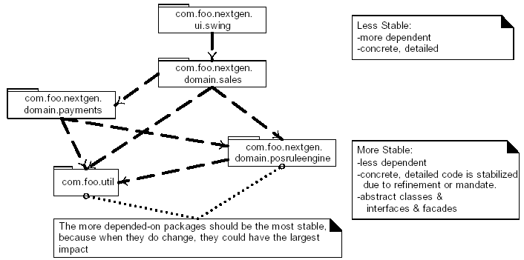
Most Responsible Are Most Stable
Notes:
The following page numbers will help the instructor find the answers to the review questions:
Question 1: pp. 3-4
Question 2: p. 4
Question 3: p. 10
Question 4: p. 6
Question 5: pp. 8-9

Slide 62
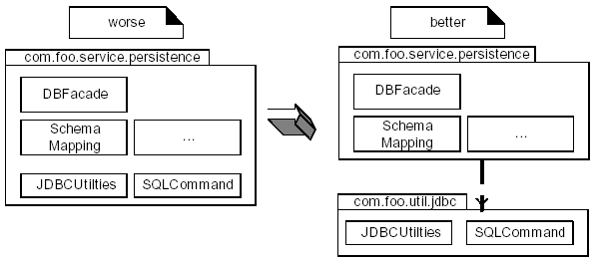
Factor out Independent Types
Notes:
The following page numbers will help the instructor find the answers to the review questions:
Question 1: pp. 3-4
Question 2: p. 4
Question 3: p. 10
Question 4: p. 6
Question 5: pp. 8-9

Slide 63
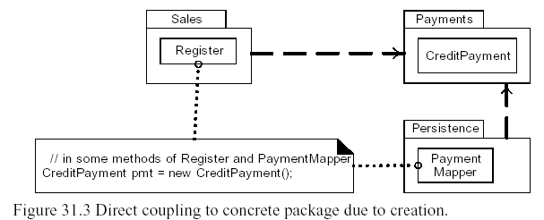
Use Factories to Reduce Dependency on Concrete Packages
Notes:
The following page numbers will help the instructor find the answers to the review questions:
Question 1: pp. 3-4
Question 2: p. 4
Question 3: p. 10
Question 4: p. 6
Question 5: pp. 8-9

Slide 64
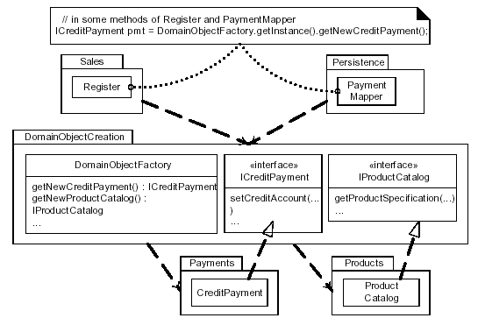
Use Factories to Reduce Dependency on Concrete Packages
Notes:
The following page numbers will help the instructor find the answers to the review questions:
Question 1: pp. 3-4
Question 2: p. 4
Question 3: p. 10
Question 4: p. 6
Question 5: pp. 8-9

Slide 65
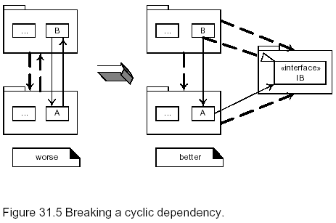
No Cycles in Packages
Notes:
The following page numbers will help the instructor find the answers to the review questions:
Question 1: pp. 3-4
Question 2: p. 4
Question 3: p. 10
Question 4: p. 6
Question 5: pp. 8-9

Slide 66
Subsystem Design

Slide 67
5.3 Subsystem Design Steps
Subsystem Design Overview
Subsystem Guidelines
Subsystem Design Steps
Checkpoints
Notes:
The above are the major steps involved in the Subsystem Design activity.
We first must take the responsibilities allocated to the subsystems and further allocate those responsibilities to the subsystem elements.
Once the subsystem elements have been identified, the internal structure of the subsystems (a.k.a. subsystem element relationships) needs to be documented.
Once we know how the subsystem will implement it’s responsibilities, we need to document the interfaces upon which the subsystem is dependent.
Finally, we’ll discuss the kinds of things you should look for when reviewing the results of Subsystem Design.
The process is similar to that defined in Use-Case Analysis, but instead of use cases we are working with interface operations. In Subsystem Design, we concentrate on developing “interface realizations” rather than “use-case realizations”.
Ask the students where the subsystem responsibilities are documented.
Answer: In the interfaces that the subsystem realizes.

Slide 68
Subsystem Design Overview
Design Subsystems and Interfaces
(updated)
Design Subsystems and Interfaces
Subsystem
Design
Use-Case Realization
Use-Case Realization
(updated)
Design
Guidelines
Design Classes
Notes:
Subsystem Design is performed once per Design Subsystem.
Purpose
To define the behaviors specified in the subsystem's interfaces in terms of collaborations of contained classes
To document the internal structure of the subsystem
To define realizations between the subsystem's interfaces and contained classes
To determine the dependencies upon other subsystems
Input Artifacts
Use-Case Realizations
Design Subsystem with Interface Definitions
Design Guidelines
Contains detailed usage information for the architectural mechanisms
Resulting Artifacts
Use-Case Realizations (updated)
Detailed design of the subsystem may result in changes to the use-case realization.
Design Subsystem with Interface Definitions (updated)
Detailed design of the subsystem may result in changes to the subsystem and interface definitions.
Design Classes
In Subsystem Design, the concentration is on developing the “interface realizations”.

Slide 69
Subsystem Design - Purpose
To define the behaviors specified in the subsystem's interfaces in terms of collaborations of contained classes
To document the internal structure of the subsystem
To define realizations between the subsystem's interfaces and contained classes
To determine the dependencies upon other subsystems
Notes:
In the Best Practices module, we discussed some characteristics common to successful projects. OO facilitates the following best practices:
Develop Iteratively
Model Visually
Use Component Architecture
Defining basic OO terms and concepts allows everyone in the class to start on a level playing field.

Slide 70
Review: Subsystems and Interfaces
A Subsystem:
Is a “cross between” a package and a class
Realizes one or more interfaces which define its behavior
<<interface>>
Interface
<<subsystem>>
Subsystem Name
Realization (Canonical form)
Subsystem
Interface
<<subsystem>>
Subsystem Name
Interface
Realization (Elided form)
Notes:
Subsystems and interfaces were first introduced in the Concepts of Object Orientation module. They were identified and modeled in Identify Design Elements. The concepts are repeated here for review purposes.
In the UML, any classifier (e.g., class, subsystem, component) can have interface(s); however, to keep things simple, in this course we will concentrate on interfaces for subsystems.
Emphasize the following:
Canonical vs. elided notation
Multiple interfaces possible per subsystem
Interface can be realized by multiple subsystems
Interface is not a part of the subsystem, it is external
Remember that interfaces and abstract classes/generalization are not the same concept. An interface is a full-fledged citizen that may be “realized” (excuse the overloaded term) using abstract classes. Though the realization of an interface is not the same as inheriting from an abstract base class.
A subsystem is a model element which has the semantics of a package, such that it can contain other model elements, and a class, such that it has behavior. A subsystem realizes one or more interfaces, which define the behavior it can perform.
A subsystem may be represented as a UML package (a tabbed folder) with the «subsystem» stereotype.
An interface is a model element which defines a set of behaviors (a set of operations) offered by a classifier model element (specifically, a class, subsystem or component). A classifier may realize one or more interfaces. An interface may be realized by one or more classifiers.
Interfaces are not abstract classes, as abstract classes allow you to provide default behavior for some/all of their methods. Interfaces provide no default behavior.
Interfaces may be represented as classes with the “interface” stereotype, or may be represented as “lollipops”.
Realization is a semantic relationship between two classifiers. One classifier serves as the contract that the other classifier agrees to carry out.
The realization relationship may be modeled as a dashed line with a hollow arrow head pointing at the contract classifier (canonical form), or when combined with an interface, as a “lollipop” (elided form).

Slide 71
Subsystem Guidelines
Goals
  Loose coupling
  Portability, plug-and-play compatibility
  Insulation from change
  Independent evolution
Strong Suggestions
  Don’t expose details, only interfaces
  Only depend on other interfaces
<<subsystem>>
A
<<subsystem>>
B
<<subsystem>>
C
Key is abstraction and encapsulation
Notes:
Discuss some of the benefits of doing this well: portability, reuse, insulation from change, etc.
There should not be any public classes within a subsystem; the only thing a subsystem should expose to the outside world is its interfaces.
These guidelines will be applied throughout this module as we describe how to perform the detailed design of a subsystem. This slide is meant to provide the student with an “overall vision” for the subsystem design.
Each subsystem should be as independent as possible from other parts of the system. It should be possible to evolve different parts of the system independently from other parts. This minimizes the impact of changes and eases maintenance efforts.
It should be possible to replace any part of the system with a new part, provided the new part supports the same interfaces. In order to ensure that subsystems are replaceable elements in the model, the following are necessary:
A subsystem should not expose any of its contents. No element contained by a subsystem should have 'public’ visibility. No element outside the subsystem should depend on the existence of a particular element inside the subsystem.
A subsystem should only depend on the interfaces of other model elements, so that it is not directly dependent on any specific model elements outside the subsystem. The exceptions are cases where a number of subsystems share a set of class definitions in common, in which case those subsystems 'import' the contents of the packages which contain the common classes. This should only be done with packages in lower layers in the architecture, and only to ensure that common definitions of classes which must pass between subsystems are consistently defined.
All dependencies on a subsystem should be dependencies on the subsystem interfaces. Clients of a subsystem are dependent on the subsystem interface(s), not on elements within the subsystem. In that way, the subsystem can be replaced by any other subsystem that realizes the same interfaces.

Slide 72
Review: Modeling Convention for Subsystems and Interfaces
<<subsystem>>
CourseCatalogSystem
ICourseCatalogSystem
<<subsystem>> package
<<subsystem proxy>> class
Interfaces start with an “I”
<<subsystem>>
CourseCatalogSystem
<<subsystem proxy>>
CourseCatalogSystem
ICourseCatalogSystem
Notes:
This modeling convention was presented in Identify Design Elements. It is repeated here for review purposes.
There may be some concern over the use of “proxy”. However, using <<subsystem proxy>> should remove any ambiguous confusion with the "proxy" design pattern (although it is, in a loose way, an instance of the design pattern, at least at design time).
The subsystem proxy class may act in place of the subsystem in sequence diagrams, collaboration diagrams. Use a subsystem proxy when you want to indicate usage of a specific subsystem. The subsystem proxy realizes the interfaces realized by the subsystem.
As discussed in Identify Design Elements, for this course, we will represent subsystems as three items in the model:
A <<subsystem>> package (package with a stereotype of <<subsystem>>),
A <<subsystem proxy>> class (class with a stereotype of <<subsystem proxy>>), and
A subsystem interface (class with a stereotype of <<interface>>). The interface names should start with an ‘I’.
The <<subsystem>> package provides a container for the elements that comprise the subsystem, the interaction diagrams that describe how the subsystem elements collaborate to implement the operations of the interfaces the subsystem realizes, and other diagrams that clarify the subsystem elements.
The <<subsystem proxy>> class actually realizes the interface and will orchestrate the implementation of the subsystem interface operations.
Such conventions make the consistent modeling of subsystems easier. In this course, we will utilize this convention in representing subsystems on our diagrams.
Remember, interfaces are EXTERNAL to the subsystem.

Slide 73
Subsystem Design Steps
Distribute subsystem behavior to subsystem elements
Document subsystem elements
Describe subsystem dependencies
Notes:
The above are the major steps involved in the Subsystem Design activity.
We first must take the responsibilities allocated to the subsystems and further allocate those responsibilities to the subsystem elements.
Once the subsystem elements have been identified, the internal structure of the subsystems (a.k.a. subsystem element relationships) needs to be documented.
Once we know how the subsystem will implement it’s responsibilities, we need to document the interfaces upon which the subsystem is dependent.
Finally, we’ll discuss the kinds of things you should look for when reviewing the results of Subsystem Design.
The process is similar to that defined in Use-Case Analysis, but instead of use cases we are working with interface operations. In Subsystem Design, we concentrate on developing “interface realizations” rather than “use-case realizations”.
Ask the students where the subsystem responsibilities are documented.
Answer: In the interfaces that the subsystem realizes.

Slide 74
Subsystem Responsibilities
Subsystem responsibilities defined by interface operations
  Model interface realizations
Interface operations may be realized by
  Internal class operations
  Internal subsystem operations
<<interface>>
ICourseCatalogSystem
<<subsystem>>
getCourseOfferings()
CourseCatalogSystem
subsystem responsibility
Notes:
The external behaviors of the subsystem are defined by the interfaces it realizes. When a subsystem realizes an interface, it makes a commitment to support each and every operation defined by the interface.
The operation may be in turn realized by:
An operation on a class contained by the subsystem; this operation may require collaboration with other classes or subsystems
An operation on an interface realized by a contained subsystem
The collaborations of model elements within the subsystem should be documented using sequence diagrams which show how the subsystem behavior is realized. Each operation on an interface realized by the subsystem should have one or more documenting sequence diagrams. This diagram is owned by the subsystem, and is used to design the internal behavior of the subsystem.
In Rose, interface realizations can be documented using a variant of the use-case realization idea. Essentially, a <<interface realization>> stereotyped use case is created inside the <<subsystem>> package with the same name as the interface it models. Thus, there is one <<interface realization>> use case (e.g., UML collaboration) for each interface the subsystem realizes. The interface realization contains the static and dynamic models that describe how the subsystem realizes the interfaces (e.g., a class diagram and interaction diagrams – at least one interaction diagram per interface operation). As with use-case realizations, the interface realization does not contain any classes (they “live” in the <<subsystem>> package or in other design element packages).
This fits well with the large-scale ‘systems-of-systems’ development idea where you would have subsystem use cases and their corresponding realizations, and also keeps the diagrams neat.
This convention is not part of the tool mentors yet, bit it was used in the sample models provided with the OOADcourse materials.

Slide 75
Distributing Subsystem Responsibilities
Identify new, or reuse existing, design elements (e.g., classes and/or subsystems)
Allocate subsystem responsibilities to design elements
Incorporate applicable mechanisms (e.g., persistence, distribution, etc.)
Document design element collaborations in “interface realizations”
  One or more interaction diagrams per interface operation
  Class diagram(s) containing the required design element relationships
Revisit “Identify Design Elements”
  Adjust subsystem boundaries and/or dependencies, as needed
Notes:
You may find additional classes and/or subsystems during this activity. If so, the added classes and relationships must be consistent with the established architecture.
Sometimes you see repeated patterns of interaction in these early interface realizations that give birth to new subsystems and some revisions in the interface realizations. It is important for the Architect to look within and across subsystems for common behavior (i.e., common collaborations) within the subsystems, pulling it out where possible. This is a reuse scavenging activity that falls under the Identify Design Elements umbrella.
It is important to describe the collaborations to support the design and implementation mechanisms defined in Identify Design Mechanisms.
For each interface operation, identify the classes (or where the required behavior is complex, a contained subsystem) within the current subsystem which are needed to perform the operation. Create new classes/subsystems where existing classes/subsystems cannot provide the required behavior (but try to reuse first).
Creation of new classes and subsystems should force reconsideration of subsystem content and boundary. Be careful to avoid having effectively the same class in two different subsystems. Existence of such a class implies that the subsystem boundaries may not be well-drawn. Periodically revisit Identify Design Elements to re-balance subsystem responsibilities.
The collaborations of model elements within the subsystem should be documented using interaction diagrams which show how the subsystem behavior is realized. Each operation on an interface realized by the subsystem should have one or more documenting interaction diagrams. This "internal" interaction diagram shows exactly what classes provide the interface, what needs to happen internally to provide the subsystem’s functionality, and which classes send messages out from the subsystem. These diagram are owned by the subsystem, and are used to design the internal behavior of the subsystem. The diagrams are essential for subsystems with complex internal designs. It also enables the subsystem behavior to be easily understood, hopefully rendering it reusable across contexts.
These internal interaction diagrams should incorporate any applicable mechanisms initially identified in Identify Design Mechanisms (e.g., persistence, distribution, etc.)

Slide 76
Subsystem Dependencies: Guidelines
Subsystem dependency on a subsystem
Subsystem dependency on a package
<<subsystem>>
<<subsystem>>
Flexible, Preferred
Client Support
Server Support
Server
<<subsystem>>
Supporting
Types
Use with care
Client Support
Notes:
Create a dependency association between the subsystem and each package/subsystem interface the subsystem is dependent upon. As a result, existing subsystem relationships and possibly subsystem interfaces may need to be refined.
Using interface dependencies allows flexible frameworks to be designed using replaceable design elements.
Note: Any changes to subsystem interfaces or to relationships between subsystems must be evaluated from an architecture perspective (see Identify Design Elements).
When a subsystem element uses some behavior of an element contained by another subsystem or package, a dependency on the external element is needed.
If the element on which the subsystem is dependent is within a subsystem, the dependency should be on the subsystem interface, not on the subsystem itself or on any element in the subsystem. This allows the design elements to be substituted for one another as long as they offer the same behavior. It also gives the designer total freedom in designing the internal behavior of the subsystem, as long as it provides the correct external behavior. If a model element directly references a model element in another subsystem, the designer is no longer free to remove that model element or redistribute the behavior of that model element to other elements. As a result, the system is more brittle.
If the element the subsystem element is dependent on is within a package, the dependency should be on the package itself. Ideally, a subsystem should only depend on the interfaces of other model elements for the reasons stated above. The exception is where a number of subsystems share a set of common class definitions, in which case those subsystems 'import' the contents of the packages containing the common classes. This should only be done with packages in lower layers in the architecture to ensure that common class definitions are defined consistently. The disadvantage is that the subsystem cannot be reused independent of the depended-on package.

Slide 77
Use Case Design

Slide 78
5.4 Use Case Design
Use Case Design Overview
Use Case Design Steps
Notes:
The above are the major steps involved in the Subsystem Design activity.
We first must take the responsibilities allocated to the subsystems and further allocate those responsibilities to the subsystem elements.
Once the subsystem elements have been identified, the internal structure of the subsystems (a.k.a. subsystem element relationships) needs to be documented.
Once we know how the subsystem will implement it’s responsibilities, we need to document the interfaces upon which the subsystem is dependent.
Finally, we’ll discuss the kinds of things you should look for when reviewing the results of Subsystem Design.
The process is similar to that defined in Use-Case Analysis, but instead of use cases we are working with interface operations. In Subsystem Design, we concentrate on developing “interface realizations” rather than “use-case realizations”.
Ask the students where the subsystem responsibilities are documented.
Answer: In the interfaces that the subsystem realizes.

Slide 79
Use-Case Design Overview
Supplementary
Specifications
Design Subsystems and Interfaces
Use-Case
Design
Use-Case Realization
Use-Case Realization
(Refined)
Design Classes
use-case
Notes:
Use-Case Design is performed by the Designer, once per use-case.
Purpose
To refine use-case realizations in terms of design element interactions
To refine requirements on the operations of design classes
To refine requirements on the operations of subsystems and/or their interfaces
Input Artifacts
Supplementary Specifications
use-cases
Use-Case Realizations
Design Classes
Design Subsystems
Interfaces
Resulting Artifacts
Use-Case Realizations, described with class diagrams, interaction diagrams, and flow of events refined.
It is important to describe that there are different Designers (or Design teams) on a project, each with a different focus. Use-Case Designers are concerned with the design of the use-case realizations for a particular use-case, coordinating with the necessary architects, subsystem designers and class designers.
The use-case designer concentrates on the interactions between subsystems and “free” (not contained in a subsystem) classes. They can defer responsibility for what happens inside the subsystems to the subsystem designer(s).
That’s the beauty of encapsulation
Be careful with the discussion of project team organization, as you don’t want the discussion to turn into a discussion of OO project management concerns. Refer the students to the OOPM course for more details on team organization.

Slide 80
Use Case Design - Purpose
To refine use-case realizations in terms of interactions
To refine requirements on the operations of design classes
To refine requirements on the operations of subsystems and/or their interfaces.
Notes:
In the Best Practices module, we discussed some characteristics common to successful projects. OO facilitates the following best practices:
Develop Iteratively
Model Visually
Use Component Architecture
Defining basic OO terms and concepts allows everyone in the class to start on a level playing field.

Slide 81
Use-Case Design Steps
Describe interaction between design objects
Simplify sequence diagrams using subsystems
Describe persistence related behavior
Refine the flow of events description
Unify classes and subsystems
Notes:
The above are the major steps of the Use-Case Design activity.
Use-case realizations evolve from interactions amongst analysis classes to interactions amongst design elements (e.g., design classes and subsystems).
The purpose of Use-Case Design is to make sure these are consistent and make sense. During Use-Case Design, the focus is on the use-case, and this includes crossing subsystem boundaries. The use-case designer needs to make sure the use-case is implemented completely and consistently across the subsystems.
Anything done from the use-case perspective is part of Use-Case Design.
We will address each of these steps in this module.
In Use-Case Design, we basically do two things to the Use-Case Realizations originally developed during Use-Case Analysis:
Replace analysis classes with their corresponding design elements (e.g., use subsystem interfaces, where applicable),
Incorporate any applicable architectural mechanisms, using the sample interaction and class diagrams provided by the Architects.

Slide 82
Class Design

Slide 83
5.5 Class Design
Create Initial Design Classes
Define Operations
Define Methods
Define States
Define Attributes
Define Dependencies
Define Associations
Notes:
The Class Design steps we will address in this module of are listed above.

Slide 84
Class Design Considerations
Class stereotype
  Boundary
  Entity
  Control
Applicable design patterns
Architectural mechanisms
  Persistence
  Distribution
  etc.
Notes:
During design, you are more concerned with taking the analysis model and refining it to meet implementation demands such as language and environment. Thus, the analysis stereotypes become less of an issue. Once you get into design, down to the widget and gizmo level, many of the 'analysis' classes have long since morphed into other things, or their responsibilities have been scattered amongst a handful of classes.
An analogy might be cells in an organism: from a high-level perspective, it's useful to characterize them according to their role: epidermal, neuron, and muscle. At a cellular chemistry level, these distinctions are not as important when we are looking at how each cell works, since there are many kinds of neurons, etc.
The available design mechanisms were identified, characterized, and mapped to the Analysis Mechanisms by the architect during the Identify Design Mechanisms activity
When performing Class Design, you need to consider:
How the classes that were identified in analysis as boundary, control, and entity classes will be realized in the implementation
How design patterns can be used to help solve implementation issues
How the architectural mechanisms will be realized in terms of the defined design classes.
There are specific strategies that can be used to design a class, depending on its original analysis stereotype (boundary, control and entity). These stereotypes are most useful during Use-Case Analysis when identifying classes and allocating responsibility. At this point in design, you really no longer need to make the distinction -- the purpose of the distinction was to get you to think about the roles objects play, and making sure that you separate behavior according to the forces which cause objects to change. Once you have considered these forces and have a good class decomposition, the distinction is no longer really useful.
Here the class is refined to incorporate the architectural mechanisms.
When you identify a new class, make an initial pass at its relationships. This is just the initial associations that tie the new classes into the existing class structure. These will be refined throughout Class Design.

Slide 85
How Many Classes Are Needed?
Many, simple classes means that each class
  Encapsulates less of the overall system intelligence
  Is more reusable
  Is easier to implement
A few, complex classes means that each class
  Encapsulates a large portion of the overall system intelligence
  Is less likely to be reusable
  Is more difficult to implement
A class should have a single well focused purpose. A class should do one thing and do it well!
Notes:
These are some things you should think about as you define additional classes.
The proper size of a class will depend heavily on the implementation environment. Classes should map directly to some phenomenon in the implementation language in such a way that the mapping results in good code.
With that said, you should design as if you had classes and encapsulation even if your implementation language does not support it. This will help keep the structure easy to understand and modify.

Slide 86
Strategies for Designing Boundary Classes
User interface (UI) boundary classes
  What user interface development tools will be used?
  How much of the interface can be created by the development tool?
External system interface boundary classes
  Usually model as subsystem
MainWindow
SubWindow
MainForm
Button
DropDownList
Notes:
Remember: Boundary classes manage the interface communications between actors and the system. They provide the capability to send and receive information from outside the system.
Interaction diagrams provide a good source for interface requirements: something in the system must provide the capability to receive all “messages” coming from an actor, and something in the system must provide the capability to send all “messages” going to an actor. This “something” is the defined boundary classes.
GUI design can actually be started early on in the project. UI prototyping is sometimes done in conjunction with use-case development – it can be an excellent requirements elicitation technique.
GUI design could be done in a 4GL, reverse engineered (using Rose) and then incorporated into your application design model. The goal is to use the tool best suited for the job (Rose is not meant to be a GUI design tool). GUI design is out of the scope of this course, so for our examples, the analysis boundary classes will remain “as is” design.
Remind the students of the design of the Main application forms in Identify Design Elements.
During analysis, high-level boundary classes are identified. During design, the design must be completed. You may need to create additional classes to support actual GUI and external system interactions.
Some mechanisms used to implement the UI can be architecturally significant. These should be identified and described by the architect in the Identify Design Mechanisms activity, and applied by the designer here in the Class Design activity. Design of user interface boundary classes will depend on the user interface development tools being used on the project. You only need design what the development environment will not automatically create for you. All GUI builders are different. Some create objects containing the information from the window. Others create data structures with the information. Any prototyping of the user interface done earlier is a good starting point for this phase of design.
Since interfaces to external systems usually have complex internal behavior, they are typically modeled as subsystems. If the interface is less complex, such as a pass through to an existing API, you may represent it with one or more design classes. In the latter case, use a single design class per protocol, interface, or API.

Slide 87
Strategies for Designing Entity Classes
Entity objects are often passive and persistent
Performance requirements may force some re-factoring
See Identify Persistent Classes step
Analysis
Design
<< entity >>
FatClass
FatClass
- transientBookeeping
- transientBookeeping
- commonlyUsedAtt1
+ getCommonlyUsedAtt1()
- commonlyUsedAtt2
+ getCommonlyUsedAtt2()
- rarelyUsedAtt3
+ getRarelyUsedAtt3()
- rarelyUsedAtt4
+ getRarelyUsedAtt4()
1
1
FatClassDataHelper
FatClassLazyDataHelper
- commonlyUsedAtt1
- rarelyUsedAtt3
- commonlyUsedAtt2
- rarelyUsedAtt4
Notes:
Persistence mechanisms may also require some re-factoring – for example, when some of the data is to be stored in one place (e.g., a relational database) and some is to be stored in another place (an OO database).
A broader discussion of design issues for persistent classes is presented later in this module in the Identify Persistent Classes step.
During analysis, entity classes may have been identified and associated with the analysis mechanism for persistence, representing manipulated units of information. Performance considerations may force some re-factoring of persistent classes, causing changes to the Design Model which are discussed jointly between the Database Designer and the Designer responsible for the class. The details of a database-based persistence mechanism are designed during Database Design, which is out of the scope of this course.
Here we have a persistent class with five attributes. One attribute is not really persistent, it is used at runtime for bookkeeping. From examining the use-cases, we know that two of the attributes are used frequently. Two other attributes are used less frequently. During design, we decide that we’d like to retrieve the commonly used attributes right away, but only retrieve the rarely used ones if we some client asks for them. We don’t want to make a complex design for the client, so, from a data standpoint, we will consider the FatClass to be a proxy in front of two real persistent data classes. It will retrieve the FatClassDataHelper from the database when it is first retrieved. It will only retrieve the FatClassLazyDataHelper from the database in the rare occasion that a client asks for one of the rarely used attributes.
Such behind-the-scenes implementation is an important part of tuning the system from a data-oriented perspective while retaining a logical object-oriented view for clients to use.

Slide 88
Strategies for Designing Control Classes
What happens to Control Classes?
  Are they really needed?
  Should they be split?
How do you decide?
  Complexity
  Change probability
  Distribution and performance
  Transaction management
Notes:
If control classes seem to be just “pass throughs” from the boundary classes to the entity classes, they may be eliminated.
Control classes may become true design classes for any of the following reasons:
They encapsulate significant control flow behavior
The behavior they encapsulate is likely to change
The behavior must be distributed across multiple processes and/or processors
The behavior they encapsulate requires some transaction management.
We saw in Describe Distribution how what was a single control classes in analysis, became two classes in design (a proxy and a remote). For our example, the control classes were needed in design.

Slide 89
Operations: Where Do You Find Them?
Messages displayed in interaction diagrams
Other implementation dependent functionality
  Manager functions
  Need for class copies
  Need to test for equality
:ClassA
:ClassB
:ClassA
:ClassB
// Perform responsibility
performResponsibility():result
Notes:
Emphasize how operations and attributes are domain dependent. As a quick in-class exercise: pick a class, pick two different domains, pick two students; one for each domain, and have them choose relevant operations and attributes for the class.
Stress that because the process is use-case-driven, all discovered operations and attributes should support at least one use-case. Thus, the attributes/operations that are discovered are effected by what functionality/domain you are modeling.
While discussing where to find operations, it is worth exploring with which object an operation belongs. You will find that the operation always goes in the supplier object. On the interaction diagram, the client is initiating a request from the supplier; so the supplier object/class has the operation. Some people, especially people used to functional decomposition, get this confused initially.
To identify operations on design classes:
Study the responsibilities of each corresponding analysis class, creating an operation for each responsibility. Use the description of the responsibility as the initial description of the operation.
Study the use-case realizations in the class participations to see how the operations are used by the use-case realizations. Extend the operations, one use-case realization at a time, refining the operations, their descriptions, return types and parameters. Each use-case realization's requirements, as regards classes, are textually described in the Flow of Events of the use-case realization.
Study the use-case Special Requirements, to make sure that you do not miss implicit requirements on the operation that might be stated there.
Use-case realizations cannot provide enough information to identify all operations. To find the remaining operations, consider the following:
Is there a way to initialize a new instance of the class, including connecting it to instances of other classes to which it is associated?
Is there a need to test to see if two instances of the class are equivalent?
Is there a need to create a copy of a class instance?
Are any operations required on the class by mechanisms which they use? (Example: a “garbage collection” mechanism may require that an object be able to drop all of its references to all other objects in order for unused resources to be freed.)

Slide 90
Name and Describe the Operations
Appropriate operation names
  Indicate the outcome
  Use client perspective
  Consistent across classes
Define operation signatures
  operationName(parameter : class,..) : returnType
Provide short description, including meaning of all parameters
Notes:
You can foreshadow a discussion of polymorphism here. Operations across classes that have the same signature and semantics, should return the same type of result and have the same name. Even if their implementation is different in each class.
Operations should be named to indicate their outcome. For example, getBalance() vs. calculateBalance(). One approach for naming operations that get and set properties is to simply name the operation the same name as the property. If there is a parameter, it sets the property; if not, it returns the current value.
You should name operations from the perspective of the client asking for a service to be performed by the class. For example, getBalance() vs. receiveBalance(). The same applies to the operation descriptions. Descriptions should always be written from the operation USER’s perspective. What service does the operation provide?
It is best to specify the operations and their parameters using implementation language syntax and semantics. This way the interfaces will already be specified in terms of the implementation language when coding starts.

Slide 91
Guidelines: Designing Operation Signatures
When designing operation signatures, consider if parameters are:
  Passed by-value or by-reference?
  Changed by the operation?
  Optional?
  Set to default values?
  In valid parameter ranges?
The fewer the parameters, the better
Pass objects instead of “data bits”
Notes:
In addition to the short description of the parameter be sure to include things like:
Whether the parameter should be passed by value or by reference, and if by reference, is the parameter changed by the operation? By-value means that the actual objects is passed. By-reference means that a pointer or reference to the object is passed.
The signature of the operation defines the interface to objects of that class, and the parameters should therefore be designed to promote and define what that interface is. For example, if a parameter should never be changed by the operation, then design it so that it is not possible to change it - if the implementation environment supports that type of design.
Whether parameters may be optional and/or have default values when no value is provided.
Whether the parameter has ranges of valid values.
The fewer parameters you have the better. Fewer parameters help to promote understandability, as well as maintainability, i.e. the more parameters clients need to understand the more tightly coupled the objects are likely to be conceptually.
One of the strengths of OO is that you can manipulate very rich data structures, complete with associated behavior. Rather than pass around individual data fields (e.g., StudentID), strive to pass around the actual object (e.g., Student). Then the recipient has access to all the properties and behavior of that object.

Slide 92
Operation Visibility
Visibility is used to enforce encapsulation
May be public, protected, or private
Private operations
Protected
operations
Public operations
Notes:
UML defines only public/protected/private visibility, not implementation visibility. Implementation visibility should be defined as a property string or by a tool-specific convention (UML 1.3, Notation Guide 3.25)
Re-emphasize that you must define a good abstraction – you must think about what operations are public and private and you must think about encapsulation.
Operation visibility is the realization of the key object-orientation principle of encapsulation.
Public members are accessible directly by any client.
Protected members are directly accessible only by instances of subclasses.
Private members are directly accessible only by instances of the class to which they are defined.
How do you decide what visibility to use? Look at the interaction diagrams on which the operation is referenced. If the message is from outside of the object, use public. If it is from a subclass, use protected. If it’s from itself, use private. You should define the most restrictive visibility possible that will still accomplish the objectives of the class. Client access should be granted explicitly by the class and not taken forcibly.
Visibility applies to attributes as well as operations. Attributes are discussed later in this module.

Slide 93
How Is Visibility Noted?
The following symbols are used to specify export control:
  + Public access
  # Protected access
  - Private access
Class
- privateAttribute
# protectedAttribute
+publicOp()
# protectedOp()
- privateOp()
Notes:
Note that the UML 1.3 Notation Guide explicitly states “A tool may show the visibility indication in a different way, such as by using a special icon …” so the usage of the graphical icons for export control is valid UML.
In the UML, you can specify the access clients have to attributes and operations.
Export control is specified for attributes and operations by preceding the name of the member with the following symbols:
+ Public
# Protected
- Private

Slide 94
Scope
Determines number of instances of the attribute/operation
  Instance: one instance for each class instance
  Classifier: one instance for all class instances
Classifier scope is denoted by underlining the attribute/operation name
Class
- classifierScopeAttribute
- instanceScopeAttribute
classifierScopeOperation()
instanceScopeOperation()
Notes:
In Rose, you cannot underline the class scope operation and attribute names, but you can use an attribute and operation stereotype (e.g., <<class>>) to denote class scope attributes and operations on a diagram.
The owner scope of an attribute/operation determines whether or not the attribute/operation appears in each instance of the class (instance scoped), or if there is only one instance for all instances of the class (classifier scoped).
Classifier scoped attributes and operations are denoted by underlining their names. Lack of an underline indicates instance scoped attributes and operations.
Classifier scoped attributes are shared amongst all instances of the classifier type.
In most cases, attributes and operations are instance scoped. However, if there is a need to have a single instance of an operation, say to generate a unique id amongst class instances, or to create a class instance, the classifier scope operations can be used.
Classifier scoped operations can only access classifier scoped attributes.

Slide 95
Example: Scope
<<entity>>
Student
- name
- address
- studentID
- nextAvailID : int
+ addSchedule(theSchedule : Schedule, forSemester : Semester)
+ getSchedule(forSemester : Semester) : Schedule
+ hasPrerequisites(forCourseOffering : CourseOffering) : boolean
# passed(theCourseOffering : CourseOffering) : boolean
+ getNextAvailID() : int
Notes:
In the above example, there is a single classifier scoped attribute, nextAvailID, and a single classifier scoped operation, getNextAvailID(). These classifier scoped class features support the generation of a unique id for each Student.
Each Student instance has it’s own unique StudentID. Whereas, there is only one nextAvailID for all Student instances.
The getNextAvailID() classifier scoped operation can only access the classifier scope attribute, nextAvailID.

Slide 96
Example: Define Operations
<<control>>
<<Interface>>
RegistrationController
ICourseCatalogSystem
1
(from External System Interfaces)
(from Registration)
0..*
+ getCourseOfferings()
+ submitSchedule()
+ initialize()
+ saveSchedule()
+ getCourseOfferings() : CourseOfferingList
+ getCurrentSchedule(forStudent : Student, forSemester : Semester) : Schedule
+ deleteCurrentSchedule()
+currentSchedule
<<class>> + new(forStudent : string)
0..1
<<entity>>
+ getStudent(withID : string) : Student
Schedule
0..1
0..1
(from University Artifacts)
0..*
0..*
+registrant
0..*
0..1
<<entity>>
1
+alternateCourses
Student.
+primaryCourses
(from University Artifacts)
+ getTuition() : double
0..2
0..4
+ addSchedule(theSchedule : Schedule)
+ getSchedule(forSemester : Semester) : Schedule
<<entity>>
+ deleteSchedule(forSemester : Semester)
CourseOffering
+ hasPrerequisites(forCourseOffering : CourseOffering) : boolean
(from University Artifacts)
# passed(theCourseOffering : CourseOffering) : boolean
<<class>> + getNextAvailID() : int
+ getStudentID() : int
+ getName() : string
+ getAddress() : string
Notes:
The above example is a portion of the VOPC for the Register for Courses use-case realization.
Notice the <<class >> operations.
Those operations marked with a ‘+’ are public and can be invoked by clients of the class.
Those operations marked with a ‘#’ are protected and can only be invoked by the defining class and any subclasses. These operations usually correspond to reflexive operations on the interaction diagrams.
The dependency from the Student class to the CourseOfferingClass was added to support the inclusion of the CourseOffering as a parameter to operations within the Student class.
Semester is included as the type for several parameters in the Student operations. For the Course Registration System, it is considered to be an abstract data type that has no significant behavior and thus is not modeled as a separate class.
Note: The attribute compartment has been suppressed in the above diagram.

Slide 97
Define Methods
What is a method?
  Describes operation implementation
Purpose
  Define special aspects of operation implementation
Things to consider :
  Special algorithms
  Other objects and operations to be used
  How attributes and parameters are to be implemented and used
  How relationships are to be implemented and used
Notes:
Operations define the signature for the behavior, while the method defines the implementation.
A method specifies the implementation of an operation. It describes how the operation works, not just what it does.
The method, if described, should discuss:
How operations are to be implemented.
How attributes are to be implemented and used to implement operations.
How relationships are to be implemented and used to implement operations.
The requirements will naturally vary from case to case. However, the method specifications for a class should always state:
What is to be done according to the requirements.
What other objects and operations are to be used.
More specific requirements may concern:
How parameters are to be implemented.
Any special algorithms to be used.
In many cases, where the behavior required by the operation is sufficiently defined by the operation name, description and parameters, the methods are implemented directly in the programming language. Where the implementation of an operation requires use of a specific algorithm, or requires more information than is presented in the operation's description, a separate method description is required.

Slide 98
Define States
Purpose
  Design how an object’s state affects its behavior
  Develop statecharts to model this behavior
Things to consider :
  Which objects have significant state?
  How to determine an object’s possible states?
  How do statecharts map to the rest of the model?
Notes:
This is a good point to get some interactive review, by asking the class to define what a state is and why it is important.
The state of an object is one of the possible conditions in which an object may exist.
The state an object resides in is a computational state, and is defined by the stimuli the object can receive and what operations can be performed as a result. An object that can reside in many computational states is state-controlled.
For each class exhibiting state-controlled behavior, describe the relations between an object’s states and an object’s operations.

Slide 99
What is a Statechart?
A directed graph of states (nodes) connected by transitions(directed arcs)
Describes the life history of a reactive object
State
Event
State Name
stateVar : type = value
entry/ entry action
do/ activity
exit/ exit action
event(args)
[guard condition]
/ operation(args)
^target.sendEvent(args)
Action
Activity
Transition
Notes:
The use of statecharts varies widely: Some projects use them very extensively, while other projects may only have one or two, maybe even none.
Statecharts should be used when they help to better understand and communicate the analysis and design of the project. Not all objects require state machines. If an object's behavior is simple, such that it simply stores or retrieves data, the behavior of the object is state-invariant and its state machine is of little interest.
Statecharts may be specified for classes, subsystems, interfaces, protocols, use cases, and/or entire systems.
Note: Statecharts can also be used during early analysis if you need to model the state-controlled behavior of an analysis class.
Briefly describe the icon representations in the diagram. Each of the statechart elements will be discussed ion subsequent slides.
A statechart is a tool for describing:
States the object can assume
Events that cause an object to transition from state to state
Significant activities and actions that occur as a result
A statechart is a diagram used to show the life history of a given class, the events that cause a transition from one state to another, and the actions that result from a state change. Statecharts emphasize the event-ordered behavior of a class instance.
The state space of a given class is the enumeration of all the possible states of an object.
A state is a condition in the life of an object. The state of an object determines its response to different events.
An event is a specific occurrence (in time and space) of a stimulus that can trigger a state transition.
A transition is a change from an originating state to a successor state as a result of some stimulus. The successor state could possibly be the originating state. A transition may take place in response to an event, and can be labeled with an event.
A guard condition is a Boolean expression of attribute values which allows a transition only if the condition is true.
An action is an atomic execution that results in a change in state, or the return of a value.
An activity is a non-atomic execution within a state machine.

Slide 100
Special States
Initial state
  The state entered when an object is created
  Mandatory
  Can only have one initial state
Final state
  Indicates the object’s end of life
  Optional
  May have more than one
Initial state
Final state
Notes:
There is exactly one start state and 0..* end states.
To emphasize why a start state is mandatory, ask the students to think about how they would read a diagram with no start state.
Re: "Only one initial state is permitted". This is not strictly true. When you have nested states, there can be an initial state within each nested state in addition to the one outside of them. Note that, with this caveat, Rose enforces this.
The initial state is the state entered when an object is created
An initial state is mandatory
Only one initial state is permitted
The initial state is represented as a solid circle
A final state indicates the end of life for an object
A final state is optional
More than one final state may exist
A final state is indicated by a bull’s eye

Slide 101
Identify and Define the States
Significant, dynamic attributes
Existence and non-existence of certain links
The maximum number of students per course offering is 10
numStudents < 10
numStudents > = 10
Open
Closed
Professor
Link to Professor
Exists
Link to Professor
Doesn’t Exist
0..1
0..*
Assigned
Unassigned
CourseOffering
Notes:
The states of an object can be found by looking at its class’s attributes and relationships with other classes.
Don’t forget to establish the initial and final states for the object. If there are pre-conditions or post-conditions of the initial and final states, define those as well.
It is important to not only identify the different states, but to also explicitly define what it means to be in a particular state.
The above example demonstrates two states of a CourseOffering class instance. A CourseOffering instance may have a Professor assigned to teach it or not (hence the multiplicity of 0..1 on the Professor end of the CourseOffering-Professor association). If a Professor has been assigned to the CourseOffering instance, the state of the CourseOffering instance is “Assigned”. If a Professor has not been assigned to the CourseOffering instance, the state of the CourseOffering instance is “Unassigned”.

Slide 102
Identify the Events
Look at the class interface operations
<<entity>>
CourseOffering
0..*
0..1
<<entity>>
+ addProfessor()
Professor
+instructor
+ removeProfessor()
Events: addProfessor, removeProfessor
Notes:
Determine the events to which the object responds. These can be found in the object's interfaces or protocols.
The class must respond to all messages coming into the class instances on all of the interaction diagrams. These messages should correspond to operations on the associated classes. Thus, looking at the class interface operations provides an excellent source for the events the class instance must respond to.
In the above example, two of the CourseOffering operations are: addProfessor() and removeProfessor. Each of these operations can be considered events that a CourseOffering instance must respond to.
Note: A subset of the CourseOffering behavior is shown above.

Slide 103
Identify the Transitions
For each state, determine what events cause transitions to what states, including guard conditions, when needed
Transitions describe what happens in response to the receipt of an event
<<entity>>
CourseOffering
0..*
0..1
<<entity>>
+ addProfessor()
Professor
+instructor
+ removeProfessor()
Unassigned
addProfessor
removeProfessor
Assigned
Notes:
Starting from the initial state to the final state, lay-out the top-level states the object may be in. Connect these states with transitions triggered by the appropriate events. Continue by adding these transitions
If there are multiple automatic transitions, a guard condition is needed on each transition. The conditions must be mutually exclusive.
Each state transition event can be associated with an operation. Depending on the object's state, the operation may have a different behavior. The transition events describe how this occurs.
In the above example, when a CourseOffering instance is Unassigned (meaning a Professor has not been assigned to teach it yet), and the instance receives an “addProfessor” event, the CourseOffering instance transitions into the “Assigned” state. Conversely, when a CourseOffering instance is Assigned (meaning a Professor has been assigned to teach it yet), and the instance receives a “removeProfessor” event, the CourseOffering instance transitions into the “Unassigned” state.
Note: A subset of the CourseOffering behavior is shown above.
The dashed lines show how the transition events can be traced to an operation. This is not UML.

Slide 104
Add Activities and Actions
Activities
  Associated with a state
  Start when the state is entered
  Take time to complete
  Interruptible
Actions
  Associated with a transition
  Take an insignificant amount of time to complete
  Non-interruptible
State A
action
event[ condition ] / action
activity
State B
State C
do: activity
entry: action
Notes:
Key Concepts:
Actions
Entry and Exit Actions
Activities
Automatic transitions
Activities are interruptible, actions are not. If an action can be interrupted by an event, a new state must be defined. Activities are associated with a state; actions are associated with transitions. This holds for entry and exit actions – entry actions occur for every transition into a state, and exit actions occur for every transition out of a state.
Mealy and Moore diagrams are kinds of state machines. A Mealy machine is a state machine whose actions are attached to transitions; a Moore machine is a state machine whose actions are attached to states. In practice, you typically have a mixture. UML’s statecharts support either style.
An activity is:
A non-atomic execution within a state machine
An operation that takes time to complete.
Is interruptible (i.e., an event may be received during the activity, which may result in a state change).
Activities are associated with a state. An activity starts as soon as the state is entered, and can run to completion or, as noted above, can be interrupted by an outgoing transition.
Sometimes, the sole purpose of a state is to perform an activity. An automatic transition occurs when the activity is complete.
An action is:
An atomic execution that results in a change in state, or the return of a value.
An operation that is associated with a transition.
Actions conceptually take an insignificant amount of time to complete, and are considered non-interruptible. Action names are shown on the transition arrow preceded by a slash.
When an action must occur no matter how a state is entered or exited, the action can be associated with the state. In reality, the action is associated with every transition entering or exiting the state. The action is shown inside the state icon preceded by the keyword entry or exit.

Slide 105
Example: Statechart
add student / numStudents = numStudents + 1
/ numStudents = 0
remove student / numStudents = numStudents - 1
Unassigned
closeRegistration
addProfessor
cancel
Cancelled
do: Send cancellation notices
close
removeProfessor
[ numStudents = 10 ]
cancel
cancel
Full
close[ numStudents < 3 ]
close
add student /
numStudents = numStudents + 1
[ numStudents = 10 ]
closeRegistration [ has Professor assigned ]
Assigned
closeRegistration[ numStudents >= 3 ]
Committed
do: Generate class roster
close[ numStudents >= 3 ]
remove student / numStudents = numStudents - 1
Notes:
This diagram is not in the example model (the example model has nested states with history statechart).
The above is a statechart for the CourseOffering class.
Some things to note about the above statechart:
A student may be added or removed from the course offering, when the course offering is in the assigned or unassigned state.
The closing of a course occurs in 2 phases:
1) Close registration is where course offerings are committed if they have a professor and enough students or cancelled if there is no professor. At this point, the course offering is not closed due to low enrollment because during schedule leveling, students may be added or removed from the course offering. Leveling is where it is verified that the maximum number of selected course offerings have been committed by selecting alternates, where necessary.
2) Close is where the final status of a course offering is determined. If there is a professor and there are enough students, the course offering is committed. If not, the course offering is cancelled. This is meant to occur after leveling.

Slide 106
Example: Statechart With Nested States and History
superstate
/ numStudents = 0
Open
closeRegistration
Closed
close
Cancelled
Unassigned
do: Send cancellation notices
cancel
substate
cancel
close[ numStudents < 3 ]
Full
remove a professor
[ numStudents = 10 ]
close
add a professor
closeRegistration [ has Professor assigned ]
Assigned
closeRegistration[ numStudents >= 3 ]
Committed
add student /
numStudents = numStudents + 1
do: Generate class roster
H
close[ numStudents >= 3 ]
remove student / numStudents = numStudents - 1
Notes:
This is the statechart that is in the example model.
Nested states can lead to substantial reduction of graphical complexity, allowing us to model larger and more complex problems.
The Closed superstate was defined to simplify diagram (no add or remove events supported by this superstate and its substates). The Closed superstate is used for packaging reasons only (“Cancelled” and “Committed” are two “flavors” of closed).”
Statecharts can become unmanageably large and complex. Nested states may be used to simplify complex diagrams. A superstate is a state that encloses nested states called substates. Common transitions of the substates are represented at the level of the superstate. Any number of levels of nesting is permitted.
The history indicator supports the modeling of “memorized” states. A history indicator (circled H) is placed in the state region whose last executed state needs to be “remembered” after an activity has been interrupted. The use of the history feature indicates that upon return to a superstate, the most recently visited substate will be entered.
The history indicator is a “pseudo-state”, similar to the stop state. States that make use of history must have their transition arrows going to the history pseudo-state. Transitions to the history indicator cause the last state that was executed in the enclosing state region to be resumed. Transitions to the outer boundary of the state region causes a transition back to the start state of the region. If the history feature is not used, the initial substate will always be entered when the superstate is entered.
The above is the CourseOffering class statechart where nested states with history have been used to simplify the diagram. The Open superstate was created to leverage the common transitions of the Unassigned and Assigned states. The use of the history indicator demonstrates that when the common transitions occur, the CourseOffering returns to the substate that it was in when the event was received.

Slide 107
Which Objects Have Significant State?
Objects whose role is clarified by state transitions
Complex use cases that are state-controlled
It is not necessary to model all objects
  Objects with straightforward mapping to implementation
  Objects that are not state-controlled
  Objects with only one computational state
Notes:
The state an object resides in is a computational state. It is defined by the stimuli the object can receive and what operations can be performed as a result. An object that can reside in many computational states is state-controlled.
The complexity of an object depends on:
The number of different states
The number of different events it reacts to
The number of different actions it performs that depend on its state
The degree of interaction with its environment, i.e. other objects
The complexity of conditional, repetitive transitions

Slide 108
How Do Statecharts Map to the Rest of the Model?
Events may map to operations
Methods should be updated with state-specific information
States are often represented using attributes
  This serves as input into the “Define Attributes” step
[numStudents = 10]
Open
Full
CourseOffering
add student /
numStudents = numStudents + 1
/- numStudents
+ addStudent()
(Stay tuned for derived attributes)
Notes:
Derived attributes will be discussed in the Define Attributes step.
Some state transition event can be associated with an operation. Depending on the object's state, the operation may have a different behavior. The transition events describe how this occurs.
The method description for the associated operation should be updated with the state-specific information, indicating what the operation should do for each relevant state.
Operation calls are not the only source of events. In the UML, you can model four different kinds of events:
Signals
Calls
Passing of time
Change in state.
States are often represented using attributes. The state charts serve as input into the attribute identification step.

Slide 109
Attributes: How Do You Find Them?
Examine method descriptions
Examine states
Any information the class itself needs to maintain
Notes:
Attributes the class needs to carry out its operations and the states of the class are identified during the definition of methods. Attributes provide information storage for the class instance and are often used to represent the state of the class instance. Any information the class itself maintains is done through its attributes.
You may need to add additional attributes to support the implementation and establish any new relationships that the attributes require.
Check to make sure all attributes are needed. Attributes should be justified - it is easy for attributes to be added early in the process and survive long after they are no longer needed due to shortsightedness. Extra attributes, multiplied by thousands or millions of instances, can have a large effect on the performance and storage requirements of the system.

Slide 110
Attribute Representations
Specify name, type, and optional default value
  attributeName : Type = Default
Follow naming conventions of implementation language and project
Type should be an elementary data type in implementation language
  Built-in data type, user-defined data type, or user-defined class
Specify visibility
  Public: ‘+’
  Private: ‘-’
  Protected: ‘#’
Notes:
In analysis, it was sufficient to specify the attribute name only, unless the representation was a requirement that was to constrain the designer.
During design, for each attribute, define the following:
its name, which should follow the naming conventions of both the implementation language and the project;
its type, which will be an elementary data type supported by the implementation language;
its default or initial value, to which it is initialized when new instances of the class are created
its visibility, which will take one of the following values:
Public: the attribute is visible both inside and outside the package containing the class.
Protected: the attribute is visible only to the class itself, to its subclasses, or to friends of the class (language dependent)
Private: the attribute is only visible to the class itself and to friends of the class.
For persistent classes, also include whether the attribute is persistent (the default) or transient. Even though the class itself may be persistent, not all attributes of the class need to be persistent.
The use of attributes versus composition will be discussed later in this module.

Slide 111
Derived Attributes
What is a derived attribute?
  An attribute whose value may be calculated based on the value of other attribute(s)
When do you use them?
  When there is not enough time to re-calculate the value every time it is needed
  Trade-off runtime performance vs. memory required
Notes:
Derived attributes and derived operations are not explicitly defined as part of the UML.
An example of a derived attribute is a class, Person, with a derived attribute, age.
Derived attributes and operations indicate a constraint between values. They can be used to describe a dependency between attribute values that must be maintained by the class. They do not necessarily mean that the attribute value is always calculated from the other attributes.

Slide 112
Example: Define Attributes
<<Interface>>
ICourseCatalogSystem
(from External System Interfaces)
<<control>>
RegistrationController
(from Registration)
0..1
+currentSchedule
<<entity>>
0..1
0..1
Schedule
(from University Artifacts)
- semester : Semester
0..*
0..*
0..*
+registrant
+alternateCourses
+primaryCourses
0..1
0..2
0..4
<<entity>>
<<entity>>
Student.
1
CourseOffering
(from University Artifacts)
(from University Artifacts)
- name : string
- number : String = "100"
- address : string
- startTime : Time
<<class>> - nextAvailID : int
- endTime : Time
- studentID : int
- days : string
- dateofBirth : Date
/- numStudents : int = 0
Notes:
The above example is a portion of the VOPC for the Register for Courses use-case realization. It is the same diagram that was provided earlier in the Define Operations section, except now the operation compartment has been suppressed.
Notice the <<class >> attribute.
In the above example, all attributes are private (marked with a ‘-’) to support encapsulation.
The number of students currently enrolled in the CourseOffering is represented by the derived attribute, numStudents, which has a default value of 0.
Semester, Time, and Date are included as the type for some of the attributes. For the Course Registration System, they are considered to be abstract data types that have no significant behavior and thus are not modeled as separate classes.
FYI: Remember, there is not a direct relationship between Student and CourseOffering.
Thus, the value of numStudents equals the number of links that exist from a CourseOffering instance to Schedule instances.
You don’t have to share this thought with the students if you think it will confuse them.

Slide 113
Define Dependency
What Is a Dependency?
  A relationship between two objects
Purpose
  Determine where structural relationships are NOT required
Things to look for :
  What causes the supplier to be visible to the client
Client
Supplier
Notes:
During analysis, we assumed that all relationships were structural relationships (i.e. associations or aggregations). In design, we must decide what type of communication pathway is required.
A dependency relationship denotes a semantic relationship between model elements, where a change in the supplier may cause a change in the client.

Slide 114
Dependencies vs. Associations
Associations are structural relationships
Dependencies are non-structural relationships
In order for objects to “know each other” they must be visible
  Local variable reference
  Parameter reference
  Global reference
  Field reference
Supplier2
Dependency
Association
Supplier1
Client
Notes:
There are four options for creating a communication pathway to a supplier object:
Global: The supplier object is a global object
Parameter: The supplier object is a parameter to, or the return class of, an operation in the client object
Local: The supplier object is declared locally (i.e., created temporarily during execution of an operation)
Field: The supplier object is a data member in the client object.
A dependency is a type of communication pathway that is a transient type of relationship. These occur when the visibility of global, parameter, or local.
Look at each association relationship and determine whether it should remain an association or become a dependency. Associations and aggregations are structural relationships (field visibility). Association relationships are realized by variables that exist in the data member section of the class definition. Any other relationships (global, local and parameter visibility) are dependency relationships.

Slide 115
Associations vs. Dependencies in Collaborations
An instance of an association is a link
  All links become associations unless they have global, local or parameter visibility
  Context dependent relationship
Dependencies are transient links
  Have a limited duration
  Context independent relationship
  Summary relationship
Notes:
According to the UML 1.3 Specification, a link is an instance of an association. Specifically, an association declares a connection (link) between instances of the associated classifiers (classes). A dependency relationship indicates that the implementation or functioning of one or more elements requires the presence of one or more other elements.
Note that links modeled as parameter, global or local are transient links. They exist only for a limited duration and in the specific context of the collaboration - in that sense, they are instances of the association role in the collaboration. However, the relationship in a class model (i.e. independent of context) should be, as stated above, a dependency. In “The UML Reference Manual” the definition of a transient link states: "It is possible to model all such links as associations, but then the conditions on the associations must be stated very broadly, and they lose much of their precision in constraining combinations of objects". In this situation, the modeling of a dependency is less important than the modeling of the relationship in the collaboration, because the dependency does not describe the relationship completely, only that it exists.
If you believe that a link in a collaboration is a transient link, it indicates that the context-independent relationship between the classes is a dependency. Dependency is a 'summary' relationship - for details you have to consult the behavioral model.
Context is defined as "a view of a set of related modeling elements for a particular purpose".
These guidelines should help to remove some of the mystery of determining if a relationship is a dependency or an association.
Emphasize that the designer needs to go back to the collaboration diagram to determine if the link is a dependency or not.

Slide 116
Identifying Dependencies: Considerations
Permanent relationships - Association (field visibility)
Transient relationships - Dependency
  Multiple objects share the same instance
    Pass instance as a parameter (parameter visibility)
    Make instance a managed global (global visibility)
  Multiple objects don’t share the same instance (local visibility)
How long does it take to create/destroy?
  Expensive? Use field, parameter, or global visibility
  Strive for the lightest relationships possible
Notes:
Note: If it is going to be a parameter visibility, you have to look back up the food chain to see where the class passing it as a parameter got it. For example, maybe it is used on some entity class as a parameter, but is a field on the controller.
Strive for real-world relationships. Semantic, structural relationships should be associations.
Strive for the lightest relationships possible. Dependency is the cheapest to keep, easiest to utilize and benefits from encapsulation.
Is the relationship transient? Will you need this relationship again and again, or do you just need it to do some work and then throw it away? If it’s needed again and again, i.e., if a thing appears to remain related to another thing even across the execution of one or more operations, then it is likely an association and should benefit from field visibility. Otherwise, the relationship may be transient and can have local, parameter, or global visibility.
Is the same instance shared across objects? If many objects at runtime need it again and again and they share the same instance, maybe you should pass it around as a parameter. If there is only one instance in existence in the whole process, set it up as a managed global (e.g. Singleton design pattern). If the same instance is not shared, then having a local copy will suffice (local visibility).
How long does the instance take to create/destroy? Is it expensive to connect/disconnect every time you need it? If so, you would want to give the object field, parameter, or global visibility.

Slide 117
Example: Define Dependencies (before)
<<Interface>>
ICourseCatalogSystem
(from External System Interfaces)
+ getCourseOfferings(forSemester : Semester) : CourseOfferingList
1
courseCatalog
0..*
<<control>>
<<entity>>
RegistrationController
Schedule
(from Registration)
(from University Artifacts)
currentSchedule
- semester
+ // submit schedule()
0..1
0..1
+ submit()
+ // save schedule()
+ // save()
+ // create schedule with offerings()
# any conflicts?()
+ // getCourseOfferings(forSemester) : CourseOfferingList
+ // create with offerings()
0..1
0..*
0..*
0..*
1
alternateCourses
primaryCourses
registrant
0..2
0..4
0..1
<<entity>>
<<entity>>
CourseOffering
Student
(from University Artifacts)
(from University Artifacts)
- number : String = "100"
- name
- startTime : Time
- address
- endTime : Time
- StudentID : int
- days : Enum
+ addSchedule(theSchedule : Schedule, forSemester : Semester)
+ addStudent(studentSchedule : Schedule)
+ getSchedule(forSemester : Semester) : Schedule
+ removeStudent(studentSchedule : Schedule)
+ hasPrerequisites(forCourseOffering : CourseOffering) : boolean
+ new()
# passed(theCourseOffering : CourseOffering) : boolean
+ setData()
Notes:
The above class diagram is a subset of the View of Participating Classes (VOPC) from the Register for Courses use case.
Up to this point, most of the relationships that we have defined have been associations (and aggregations). Now we will see how some of these associations/aggregations are refined into dependencies.
The dependency shown above from Schedule to CourseOffering was previously defined in the Define Operations section to support the Schedule operation signatures.
Note: All association/aggregation relationships should be examined to see if they should be dependencies. We have just chosen to work with a VOPC subset for this example.

Slide 118
Example: Define Dependencies (after)
<<Interface>>
ICourseCatalogSystem
(from External System Interfaces)
+ getCourseOfferings(forSemester : Semester) : CourseOfferingList
Global visibility
<<control>>
<<entity>>
RegistrationController
Schedule
(from Registration)
(from University Artifacts)
currentSchedule
- semester
+ // submit schedule()
0..1
0..1
+ submit()
+ // save schedule()
+ // save()
+ // create schedule with offerings()
# any conflicts?()
Field visibility
+ // getCourseOfferings(forSemester) : CourseOfferingList
+ // create with offerings()
0..1
0..*
0..*
0..*
Field visibility
1
alternateCourses
primaryCourses
registrant
0..2
0..4
0..1
<<entity>>
<<entity>>
CourseOffering
Student
(from University Artifacts)
(from University Artifacts)
- number : String = "100"
- name
- startTime : Time
- address
- endTime : Time
- StudentID : int
- days : Enum
+ addSchedule(theSchedule : Schedule, forSemester : Semester)
+ addStudent(studentSchedule : Schedule)
+ getSchedule(forSemester : Semester) : Schedule
+ removeStudent(studentSchedule : Schedule)
+ hasPrerequisites(forCourseOffering : CourseOffering) : boolean
+ new()
# passed(theCourseOffering : CourseOffering) : boolean
+ setData()
Parameter visibility
Notes:
If the students would like an example of global visibility, tell them that all relationships to the Java RMI Naming class would be a good example of global visibility.
Note: On the presented slide, the changes made are shown in blue, but this does not show up in the back-and-white manuals.
The above example demonstrates how an association on the class diagram provided on the previous slide has been refined into a dependency relationship.
During a registration session, the RegistrationController works with one Student, the registrant (i.e., the Student that is registering), and one Schedule, the current Schedule (the Student’s Schedule for the current semester). These instances need to be accessed by more than one of the RegistrationController’s operations, so Field visibility is chosen from RegistrationController to Student and from RegistrationController to Schedule. Thus, the relationships remain associations.
A Student manages its own Schedules, so Field visibility is chosen from Student to Schedule and the relationship remains an aggregation.
CourseOfferings are part of the semantics of what defines a Schedule (a Schedule is the courses a that a Student has selected for a semester). Thus, Field visibility is chosen from Schedule to CourseOffering and the relationships remain associations.
The Student class has several operations where CourseOffering appears in the parameter list. Thus, Parameter visibility is chosen from Student to CourseOffering. This relationship was actually defined earlier in the Define Operations section.
It is envisioned that the course Catalog System may need to be accesses by multiple clients in the system, so Global visibility was chosen, and the relationship becomes a dependency. This is the only change that was done to the relationships shown on the previous slide.

Slide 119
Define Associations
Purpose
  Refine remaining associations
Things to look for :
  Association vs. Aggregation
  Aggregation vs. Composition
  Attribute vs. Association
  Navigability
  Association class design
  Multiplicity design
Notes:
At this point, we have identified which class relationships should be dependencies. Now it’s time to design the details of the remaining associations.
Also, additional associations may need to be defined to support the method descriptions defined earlier. Remember, to communicate/send messages between their instances, classes must have relationships with each other.
We will discuss each of the “things to look for” topics on subsequent slides, except for “Association vs. Aggregation” which was discussed in Use-Case Analysis.

Slide 120
What is Composition?
A form of aggregation with strong ownership and coincident lifetimes
  The parts cannot survive the whole/aggregate
Whole
Part
Whole
Part
Composition
Notes:
Note: Compositional aggregation can be shown by nesting one class within another. However, Rose does not directly support the drawing of a class within a class.
Composition is not equivalent to containment by value, as some languages do not support containment by value (e.g., Java). By-value vs. by-reference is an implementation “thing”, whereas composition is a conceptual “thing” that can be realized in the implementation using by-value, or by-reference (if the distinction is supported). Note: In Rose, composition is modeled by specifying “by-value” for the containment property of a role of a relationship.
Composition is a form of aggregation with strong ownership and coincident lifetimes of the part with the aggregate. The whole “owns” the part and is responsible for the creation and destruction of the part. The part is removed when the whole is removed. The part may be removed (by the whole) before the whole is removed.
A solid filled diamond is attached to the end of an association path (on the “whole side”) to indicate composition.
In some cases, composition can be identified as early as analysis, but more often it is not until design that such decisions can be made confidently. That is why composition is introduced here rather than in Use-Case Analysis.

Slide 121
Aggregation: Shared Vs. Non-shared
Shared Aggregation
Non-shared Aggregation
Multiplicity > 1
Whole
1..*
0..*
Part
Multiplicity = 1
Multiplicity = 1
Whole
1
0..*
Part
Whole
1
0..*
Part
Composition
By definition, composition is non-shared aggregation
Notes:
A multiplicity of ‘0’ (i.e., “0..0”) on the aggregate/whole side is not allowed (it would mean that the association could never exist). The UML does not preclude it, but it makes no sense, so for practical reasons, the Rational Unified Process does not allow it.
0..1 and 0..* can be used to specify optionality, but on the ‘parts’ of an aggregation only. Remember, the definition of aggregation is that the part does not make sense outside the context of the whole, so having a multiplicity including 0 would make no sense (you could have a part without the whole).
Another example of shared aggregation is an engine. A specific engine may be part of many different elements (cars, boats, planes) in it’s lifetime.
For composition, the multiplicity of the aggregate end may not exceed one (it is unshared). The aggregation is also unchangeable, that is, once established its links cannot be changed. Parts with multiplicity having a lower bound of 0 can be created after the aggregate itself, but once created, they live and die with it. Such parts can also be explicitly removed before the death of the aggregate.
Non-shared aggregation does not necessarily imply composition.
An aggregation relationship that has a multiplicity greater than one established for the aggregate is called shared, and destroying the aggregate does not necessarily destroy the parts. By implication, a shared aggregation forms a graph, or a tree with many roots.
An example of shared aggregation may be between a University class and a Student class (the University being the “whole” and the Students being the “parts”). With regards to registration, a Student does not make sense outside the context of a University, but a Student may be enrolled in classes in multiple Universities.

Slide 122
Aggregation or Composition?
Consideration
  Lifetimes of Class1 and Class2
Class1
Class2
aggregation
Class1
Class2
composition
Notes:
The use of association versus aggregation was discussed in the Use-Case Analysis module. Here we discuss the use of “vanilla” aggregation versus composition.
Composition should be used over "plain" aggregation when there is a strong inter-dependency relationship between the aggregate and the parts; where the definition of the aggregate is incomplete without the parts. For example, it does not make sense to have an Order if there is nothing being ordered (i.e., Line Items).
Composition should be used when the whole and part must have coincident lifetimes. Selection of aggregation or composition will determine how object creation and deletion are designed.

Slide 123
Example: Composition
1
Student
0..*
Schedule
1
RegisterForCoursesForm
1
RegistrationController
Notes:
The above example demonstrates two examples of composition.
The top graphic demonstrates how a previous aggregation relationship has been refined into a composition relationship. The relationship from Student to Schedule is modeled as a composition because if you got rid of the Student, you would get rid of any Schedules for that Student.
The bottom graphic demonstrates how a previous association relationship has been refined into a composition relationship. It was decided that an instance of a RegistrationController would NEVER exist outside the context of a particular Register For Courses Student session. Thus, since the RegisterForCoursesForm represents a particular Register For Courses session, a RegistrationController would NEVER exist outside of the context of a particular RegisterForCoursesForm. When a MaintainScheduleForm is created, an instance of RegistrationController should always be created. When MaintainScheduleForm is deleted, the instance of the RegistrationController should always be deleted. Thus, because they now have coincident lifetimes, composition is used instead of an association.

Slide 124
Attributes Vs Composition
Use composition when
  Properties need independent identities
  Multiple classes have the same properties
  Properties have a complex structure and properties of their own
  Properties have complex behavior of their own
  Properties have relationships of their own
Otherwise use attributes
Notes:
Composition and attributes are semantically equivalent. It just depends on what you need to model to make your system understandable.
Classes are capable of expressing structure, relationships, more complex behavior. If you need any of these, use a class.
Attributes cannot have structure; they are simple values, usually instances of primitive data types. If you don’t need structure, use an attribute. If you don’t need to do more than get or set the value of something, use an attribute.
From UML 1.3:
“A data type is a type whose values have no identity, i.e. they are pure values. Data types include primitive built-in types (such as integer and string) as well as definable enumeration types (such as the predefined enumeration type boolean whose literals are false and true).”
A property of a class is something that the class knows about. You can model a class property as a class (with a composition relationship), or as a set of attributes of the class. In other words, you can use composition to model an attribute.
The decision whether to use a class and composition, or a set of attributes, depends on the following:
Do the 'properties' need to have independent identity, such that they can be referenced from a number of objects? If so, use a class and composition.
Do a number of classes need to have the same 'properties’? If so, use a class and composition.
Do the 'properties' have a complex structure, properties, and behavior of their own? If so, use a class (or classes) and composition.
Otherwise, use attributes.
The decision of whether to use attributes or a composition association to a separate class may also be determined based the degree of coupling between the concepts being represented: when the concepts being modeled are tightly connected, use attributes. When the concepts are likely to change independently, use composition.

Slide 125
Example: Attributes Vs Composition
<<entity>>
Attributes
Student
- name
<<entity>>
- address
<<classifier scope>> - nextAvailID : int
Schedule
- StudentID : int
- Semester
- dateofBirth : Date
+ submit()
+ // save()
+ addSchedule()
1
1
0..*
# any conflicts?()
+ getSchedule()
+ // create with offerings()
+ delete schedule()
+ hasPrerequisites()
+ new()
# passed()
+ passed()
Composition of separate class
Notes:
In the above example, semester is not a property that requires independent identity, nor does it have a complex structure. Thus, it was modeled as an attribute of Schedule.
On the other hand, the relationship from Student to Schedule is modeled as a composition rather than an attribute because Schedule has a complex structure and properties of its own.

Slide 126
Navigability: Which Directions Are Really Needed?
Explore interaction diagrams
Even when both directions seem required, one may work
  Navigability in one direction is infrequent
  Number of instances of one class is small
Schedule
primaryCourses
CourseOffering
0..*
0..4
?
Schedule
primaryCourses
CourseOffering
Schedule
primaryCourses
CourseOffering
0..*
0..4
0..*
0..4
Notes:
Review the basic definition of navigability with the students:
The navigability property on a role indicates that it is possible to navigate from a associating class to the target class using the association.
Because navigability is true by default, you only need to find associations (and aggregations) where all opposite link roles of all objects of a class in the association do not require navigability. In those cases, set the navigability to false on the class' role.
This is not always as straight-forward as it may seem. We’ll take a look at this in more detail on subsequent slides.
During Use-Case Analysis, associations (and aggregations) may have been assumed to be bi-directional (i.e., communication may occur in both directions).
During Class Design, the association’s navigability needs to be refined so that only the required communication gets implemented.
Navigation is readdressed in Class Design because we now understand the responsibilities and collaborations of the classes better than we did in Use-Case Analysis. We also want to refine the relationships between classes.Two-way relationships are more difficult and expensive to implement than one-way relationships. Thus, one of the goals in Class Design is the reduction of two-way (bi-directional) relationships into one-way (uni-directional) relationships.
The need for navigation is revealed by the use-cases and scenarios. The navigability defined in the class model must support the message structure designed in the interaction diagrams.
In some circumstances even if two-way navigation is required, a one-way association may suffice. For example, you can use one-way association if navigation in one of the directions is very infrequent and does not have stringent performance requirements, or the number of instances of one of the classes is very small.

Slide 127
Association Class
A class “attached” to an association
Contains properties of a relationship
One instance per link
<<entity>>
ScheduleOfferingInfo
status
// mark as selected()
// mark as cancelled()
// is selected?()
0..*
alternateCourses
0..2
<<entity>>
<<entity>>
Schedule
CourseOffering
0..*
primaryCourses
0..4
<<entity>>
PrimaryScheduleOfferingInfob
grade
// is enrolled in?()
// mark as enrolled in()
// mark as committed()
Notes:
An association class is a class that is connected to an association. It is a full-fledged class and can contain attributes, operations and other associations.
Association classes allow you to store information about the relationship itself. The association class includes information that is not appropriate for, or does not belong in the classes at either end of the relationship.
There is an instance of the association class for every instance of the relationship (i.e., for every link).
In many cases, association classes are used to resolve many-to-many relationships, as shown in the example above. In this case, a Schedule includes multiple primary CourseOfferings and a CourseOffering can appear on multiple schedules as a primary. Where would a Student’s grade for a primary CourseOffering “live”? It cannot be stored in Schedule because a Schedule contains multiple primary CourseOfferings. It cannot be stored in CourseOffering because the same CourseOffering can appear on multiple Schedules as primary. Grade is really an attribute of the relationship between a Schedule and a primary CourseOffering.
The same is true of the status of a CourseOffering, primary or alternate, on a particular Schedule.
Thus, association classes were created to contain such information. Two classes related by generalization were created to leverage the similarities between what must be maintained for primary and alternate CourseOfferings. Remember, Students can only enroll in and receive a grade in a primary CourseOffering, not an alternate.
The key thing to remember about an association class is that it is required when there is a many to many relationship between two classes. Also, the association class should only contain that information that is unique to the relationship between the two classes.

Slide 128
Example: Association Class Design
alternateCourses
0..*
0..2
Schedule
primaryCourses
CourseOffering
0..*
0..4
PrimaryScheduleOfferingInfo
- grade: char = I
Design Decisions
alternateCourses
0..*
0..2
Schedule
primaryCourseOfferingInfo
PrimaryScheduleOfferingInfo
CourseOffering
1
0..4
- grade: char = I
0..*
1
Notes:
If there are attributes on the association itself (represented by "association classes"), create a design class to represent the 'association class', with the appropriate attributes. Interpose this class between the other two classes, and by establishing associations with appropriate multiplicity between the association class and the other two classes
The above example demonstrates how an association class can be further designed.
When defining the navigability between the resulting classes, it was decided not to provide navigation directly to CourseOffering from Schedule (must go through PrimaryScheduleOfferingInfo).
Note: Association class design only needs to be done if the implementation does not directly support association classes and an exact visual model of the implementation is required. The above example is hypothetical. It is not included in the Course Registration Model provided with the course since the additional design details only complicated the design model.

Slide 129
Multiplicity Design
Multiplicity = 1, or Multiplicity = 0..1
  May be implemented directly as a simple value or pointer
  No further “design” is required
Multiplicity > 1
  Cannot use a simple value or pointer
  Further “design” may be required
Professor
instructor
CourseOffering
0..1
0..*
Needs a container
Professor
instructor
CourseOffering
0..1
0..*
Notes:
Multiplicity is the number of instances that participate in an association. Initial estimates of multiplicity made during analysis must be updated and refined during design.
All association and aggregation relationships must have multiplicity specified.
For associations with a multiplicity of 1 or 0..1, further design is not usually required, as the relationship can be implemented as a simple value or a pointer.
For associations with a multiplicity upper bound that is greater than 1, additional decisions need to be made. This is usually designed using “container” classes. A container class is a class whose instances are collections of other objects. Common container classes include: sets, lists, dictionaries, stacks, and queues.

Slide 130
Multiplicity Design Options
Explicit modeling of a container class
Note
Professor
CourseOffering
CourseOfferingList
instructor
<<entity>>
+instructor
0..1
0..*
Professor
+ new()
0..1
0..1
+ add()
1
0..*
<<entity>>
CourseOffering
List
Professor
instructor
CourseOffering
0..1
0..*
Notes:
The design of a relationship with a multiplicity greater than one can be modeled in multiple ways. You can explicitly model a container class, or you can just indicate what kind of container class will be used. The latter approach keeps the diagrams from getting too cluttered with very detailed implementation decisions. However, the former approach may be useful if you want to do code generation from your model.
Another option that is a more refined version of the first approach is to use a parameterized class (template) as the container class. This is discussed in more detail on the next few slides.
We use both approaches in the OOAD course example and exercise models.

Slide 131
What is a Parameterized Class (template)?
A class definition which defines other classes
Often used for container classes
  Some common container classes:
    Sets, lists, dictionaries, stacks, queues, …
Formal arguments
Item
Parameterized
Class
List
Notes:
Emphasize to the students that in most cases, common container classes, like List, from existing implementation libraries are often just noted as a standard approach, and are not modeled at all.
In the UML, parameterized classes are also known as templates.
The formal arguments are expressed as a parameter list (for example: [T: class, size: Int].
A parameterized class cannot be used directly, it must be instantiated to be used. It is instantiated by supplying actual arguments for the formal arguments. Instantiation is discussed on the next slide.
Container classes can be modeled as parameterized classes. Common container classes, like List, from existing implementation libraries are often just noted as a standard approach, and are not modeled at all. The standard mechanism is noted in the Design Document, or as a note on the class diagram.
Consider your implementation language when deciding to use these. Parameterized classes are not supported in every language. For example: C++ supports templates, Java does not.
See the language-specific appendices for more information.

Slide 132
Instantiating a Parameterized Class
Explicit binding
Implicit binding
Formal arguments
Instantiated Class <actual arguments>
Parameterized
Class
OR
<<bind>> <actual arguments>
Instantiated Class
Notes:
Using a parameterized class requires that you specify a bound element (i.e., actual arguments for the parameterized classes’ formal arguments).
There are two ways to show bound elements, both of which are shown above.
With the explicit method, a dependency stereotyped with <<bind>> is used to specify that the source instantiates the parameterized class using the actual parameters.
With the implicit method, a class is declared whose name provides the binding.

Slide 133
Example: Instantiating a Parameterized Class
Before
CourseOfferingList
<<entity>>
CourseOffering
1
0..*
After
Item
List
OR
List <CourseOffering>
CourseOffering
<<bind>> <CourseOffering>
CourseOfferingList
CourseOffering
Notes:
Initially, we just defined a CourseOfferingList. During detailed design, it is decided that the List class will be used as a base class for the CourseOfferingList.
There are two possible ways to represent the instantiation of a parameterized class in the UML. Both are shown above.
We use the representation on the left in the OOAD course example and exercise models, since it does not require changes to the class name.

Slide 134
Multiplicity Design: Optionality
If a link is optional, make sure to include an operation to test for the existence of the link
Professor
CourseOffering
isTeaching( ) : Boolean
0..1
0..*
hasInstructor( ) : Boolean
Notes:
If a link is optional, an operation to test for the existence of the link should be added to the class.
For example, if a Professor can be on sabbatical, a suitable operation should be included in the Professor class to test for the existence of the CourseOffering link.

